Slide 1
Pictorial Overview Year 9 History
1700 - 1919

Slide 2
World Map 1750

Slide 3
The Three Field Sysem

Slide 4
Cottage Industry

Slide 5
The Nobility

Slide 6
Fields are Enclosed

Slide 7
Industrial Revolution Factories

Slide 8
Trains are Invented

Slide 9
Canals were built to transport goods

Slide 10
Child Labour is Used

Slide 11
Working Conditions are Appalling

Slide 12
Cities are Polluted

Slide 13
Worker Homes are Slums

Slide 14
Prisons in Britain overflow into old hulk ships on the Thames

Slide 15
Britain’s Slave Trade to America

Slide 16
The Slave Triangle: trading slaves for cotton, coffee, sugar …

Slide 17
Vaccination ends Smallpox

Slide 18
The French Revolution: the people overthrow the monarchy & kill the king

Slide 19
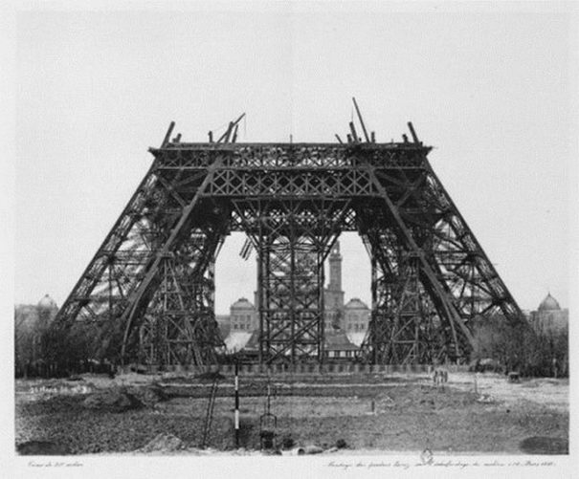
100 Years Later the French Eiffel Tower is Built

Slide 20
The Americans win independence from Britain after a bitter war

Slide 21
America builds the Statue of Liberty to celebrate independence

Slide 22
British People Emigrate

Slide 23
The First Fleet of convicts travels to Australia

Slide 24
Convict ships arrive in Australia

Slide 25
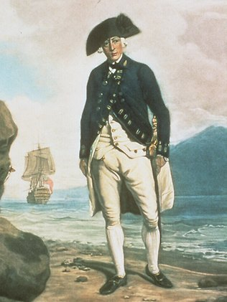
Governor Arthur Phillip

Slide 26
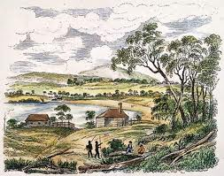
Settlers take up Land

Slide 27
Pemulwuy the Freedom Fighter

Slide 28
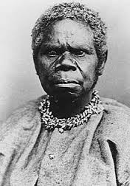
Truganini

Slide 29
Jandamara

Slide 30
Rabbit-Proof Fence

Slide 31
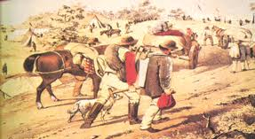
Gold Rushes

Slide 32
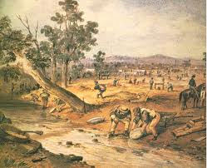
Panning for Gold

Slide 33
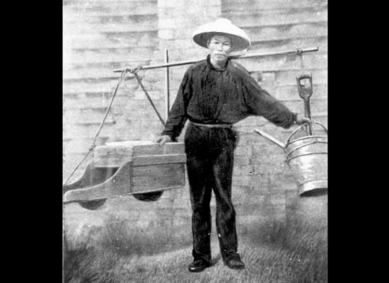
Chinese Gold Diggers

Slide 34
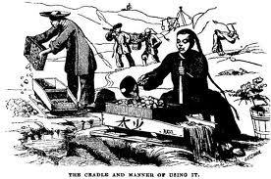
Chinese at the Diggings

Slide 35
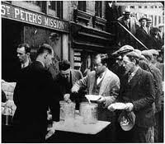
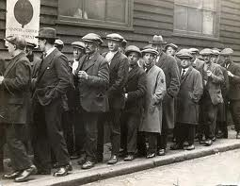
Great Depression of the 1890s

Slide 36
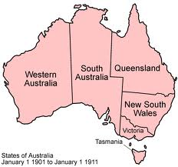
Federation 1900

Slide 37
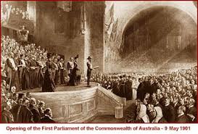
Opening of First Federal Parliament

Slide 38
Australians go to war to help Britain in a massive world war (1914-18) which kills nearly 9 million. The industries of Europe supply endless armaments and the colonies supply food and soldiers.

