Slide 1
A brief history of Japan
And comparison with Medieval England
All information – unless individually references- is directly taken from ‘History Alive 8” Jacaranda publishing 2012

Slide 2
Medieval England
500 beginning of the Medieval Period
600
Medieval Japan
700
800 growth of Feudalism
900
1000 Pope urban launches first crusades
1200
1300 Black Death
1400King Richard III
1500
500Japan ruled by Emporer Kammu
800
900
1000
1100 Kamakura period – Minimoto no Yoritomo becomes Shogun and Japan under military rule
1200
1300 Muromachi period – Ashika shonguns
1400
1500
700
600 Heian period begins- importance of art and literature, especially poetry
1600 Edo period – Japan under control of Tokugawa shoguns
1900 Tokugowan shogun overthrown – Empoer Meji is restored to power
1189-1199 Richard the Lionheart
1066-1087 William the Conqueror
1100 King Henry II 1154-1189

Slide 3
Ancient and Classical Japan
The Yamato state
The first migrants from South-East Asia settled on the southern island of Kyushu.
However, around the fourth century CE, the Yamato clan established the first Japanese state in an area around Nara on the island of Honshu.
The Yamato rulers set up a central government based on a legal system and Chinese traditions.
With support from other clan leaders, descendants of the Yamato became the first recognised emperors of Japan

Slide 4
Classical period
This era is often referred to as beginning of the ‘Classical’ period of Japanese history.
It was during this period that the first great works of Japanese literature were written and Buddhism was firmly established in Japan.
The Chinese influence was also very strong at this time: Chinese characters were used in Japanese writing, and the architecture of the capital, Nara, was modelled on the Chinese city of Xian.
More areas of Japan gradually came under the control of the emperor, but there were struggles for influence in the imperial court.
The Buddhist religion became a popular force and Buddhist priests tried to claim powerful positions.
Noble families like the Fujiwara also wanted power, so the emperor had many challenges to his authority.
Nevertheless, by the eighth century, the capital city of Nara had grown strong and was an urban centre of about 200 000 people. It had a taxation system, many roads and bustling commerce. Outside the capital though, most people still lived in farming villages

Slide 5
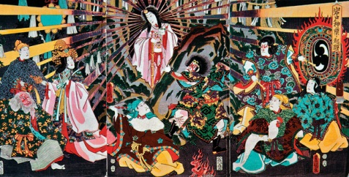
Amaterasu, the sun goddess
The imperial Yamato dynasty claimed descent from Amaterasu, the sun goddess. In Japanese mythology, when the sun goddess hid in a cave the world was plunged into darkness. Eventually she emerged and a number of her ornaments were changed into human form, one of them becoming the ancestor of the Japanese imperial family.

Slide 6
The Heian period
The emperors also relied heavily on this warrior class to help them defeat rebellious clans that challenged imperial power.
Emperor Kammu bestowed the title of seii taishogun (‘barbarian-conquering great general’) on the commander-in-chief of the military forces and gave him a great deal of power to maintain order throughout the country.
This title was later shortened to shogun and adopted by the head of the imperial military forces
In 794 the Emperor Kammu moved the imperial capital from Nara to Heian-kyo, now known as the city of Kyoto.
The Heian period that followed lasted for almost 400 years and saw the flowering of the Classical period of Japanese history.
Emperors of the Yamato dynasty found they were increasingly dependent on powerful nobles, known as daimyo, to maintain their power.
The daimyo, who usually controlled landholdings in the country areas away from the capital, employed large numbers of warriors, or samurai, to help them maintain control of these interests.

Slide 7
Complete Moodle questions on Ancient and Classical Japan.

