Slide 1
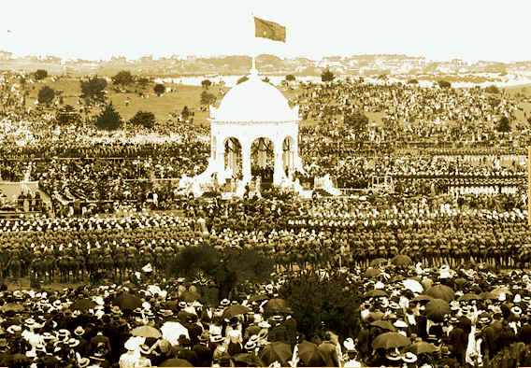
Australian Federation

Slide 2
A Continent for a Nation
http://www.youtube.com/watch?v=tjlj3KKKAlA

Slide 3
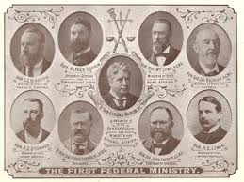
Introduction
On 1st January the Commonwealth of Australia was officially formed. Before then, each of the Australian states were separate colonies.
Federation did not just happen over night but took many years to develop, since 1890.

Slide 4
Reasons for Federation

Slide 5
Economic Advantages
Economic advantages would be gained through federating
Each colony had different tariff (tax) policies which complicated business.
Once removed under federation , they believed free trade would lower costs of production and open up new markets.
The governments of other countries, particularly Britain would be more willing to invest and grant loans to a united Australia.

Slide 6
Defence- Fear of Invasion
Defence was an issue from 1880’s onward.
Each colony had its own defence force but depended mainly on Britain’s navy for protection.
At this time, European countries were taking more interest in the region and there was concern that a stronger and more united defence force might be needed.
Australia’s very long coastline and small population also made it a target.

Slide 7
Protection of a ‘White Australia’
Some historians believe that a fear of Asian immigration was a major issue.
Since the influence of ‘foreigners’ with the gold rushes, Australians were making it increasingly clear that they wanted to preserve their colonies as a place for white people only.

Slide 8
An Australian Nationalism
In the 1880s there was a growing sense among many that Australia was ‘home’ and the Australian population was growing rapidly.
There was a sense of nationalism- a belief that your own country has special qualities that should be valued.
Newspapers, painters and poets began highlighting the Australian identity and a movement away from Britain.

Slide 9
Connecting the colonies and the world
Federation would bring uniform a communications system including telephone and postal services and transport.
Previously, each colony developed its own rail systems and track widths differed.
Improvements in communications meant that Australia would be more aware of the situation in the world around them
A major development was the telegraph, which allowed messages to be sent simultaneously via Morse code and by 1870, all Australian capitals were linked by telegraph.

