Slide 1
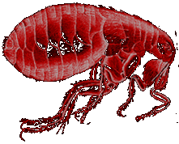
The Black Death

Slide 2
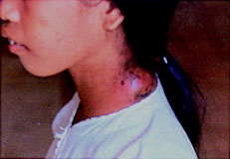
How was the plague transmitted?
We now know that the most common form of the Black Death was the BUBONIC PLAGUE! This disease was spread by fleas which lived on the black rat. The fleas sucked the rat’s blood which contained the plague germs. When the rat died the fleas jumped on to humans and passed on the deadly disease.

Slide 3
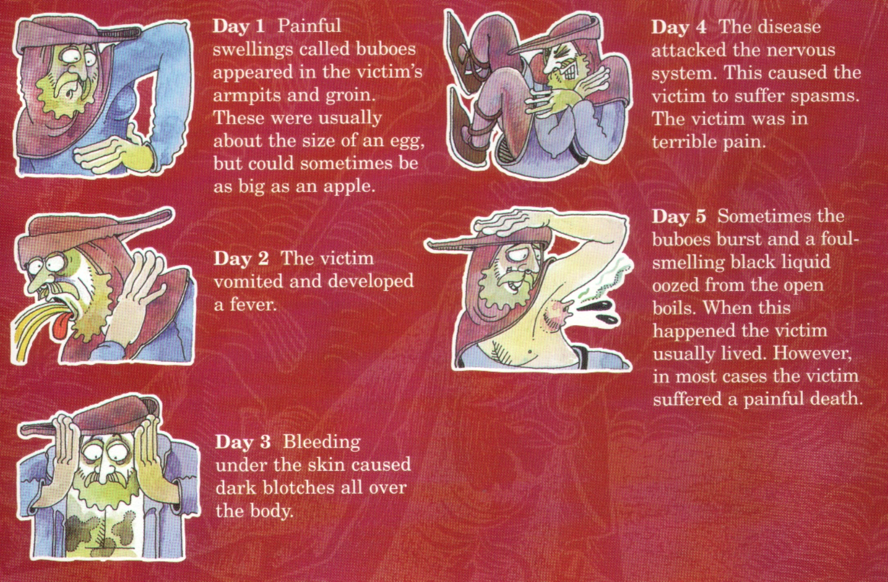
What were the symptoms of the plague?

Slide 4
The plague arrives
Historians think that the plague arrived in England during the summer of 1348. During the following autumn it spread quickly through the south west. Few villages escaped. Churchyards were full with bodies.
The plague spread quickly during the winter of 1348-1349 to the north of England. By 1350, nearly the whole of Britain was infected with the plague.
At the end of 1350 nearly two and a half million people were dead!

Slide 5
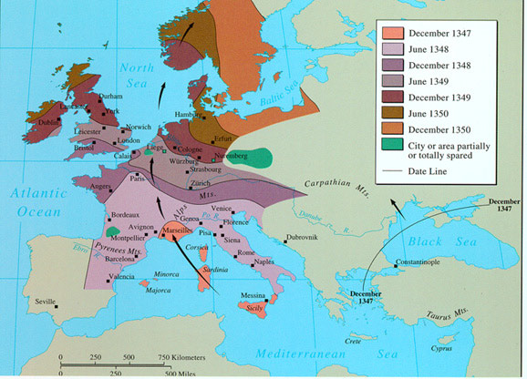
Where did the Black Death come from?

Slide 6
The Black Death
A Description of the Plague
This first account is from Messina, and it described the arrival and initial progress of the disease.
At the beginning of October, in the year of the incarnation of the Son of God 1347, twelve Genoese galleys . . . entered the harbor of Messina. In their bones they bore so virulent a disease that anyone who only spoke to them was seized by a mortal illness and in no manner could evade death. The infection spread to everyone who had any contact with the diseased. Those infected felt themselves penetrated by a pain throughout their whole bodies and, so to say, undermined. Then there developed on the thighs or upper arms a boil about the size of a lentil which the people called "burn boil".

Slide 7
This infected the whole body, and penetrated it so that the patient violently vomited blood. This vomiting of blood continued without intermission for three days, there being no means of healing it, and then the patient expired. Not only all those who had speech with them died, but also those who had touched or used any of their things. When the inhabitants of Messina discovered that this sudden death emanated from the Genoese ships they hurriedly ordered them out of the harbor and town. But the evil remained and caused a fearful outbreak of death.
Soon men hated each other so much that if a son was attacked by the disease his father would not tend him. If, in spite of all, he dared to approach him, he was immediately infected and was bound to die within three days. Nor was this all; all those dwelling in the same house with him, even the cats and other domestic animals, followed him in death. As the number of deaths increased in Messina many desired to confess their sins to the priests and to draw up their last will and testament. But ecclesiastics, lawyers and notaries refused to enter the houses of the diseased.

Slide 8
Soon the corpses were lying forsaken in the houses. No ecclesiastic, no son, no father and no relation dared to enter, but they hired servants with high wages to bury the dead. The houses of the deceased remained open with all their valuables, gold and jewels. . . .
When the catastrophe had reached its climax the Messinians resolved to emigrate. One portion of them settled in the vineyards and fields, but a larger portion sought refuge in the town of Catania. The disease clung to the fugitives and accompanied them everywhere where they turned in search of help. Many of the fleeing fell down by the roadside and dragged themselves into the fields and bushes to expire.
Those who reached Catania breathed their last in the hospitals there. The terrified citizens would not permit the burying of fugitives from Messina within the town, and so they were all thrown into deep trenches outside the walls.

Slide 9
Thus the people of Messina dispersed over the whole island of Sicily and with them the disease, so that innumerable people died. The town of Catania lost all its inhabitants, and ultimately sank into complete oblivion.
Here not only the "burn blisters" appeared, but there developed gland boils on the groin, the thighs, the arms, or on the neck. At first these were of the size of a hazel nut, and developed accompanied by violent shivering fits, which soon rendered those attacked so weak that they could not stand up, but were forced to lie in their beds consumed by violent fever.
Soon the boils grew to the size of a walnut, then to that of a hen's egg or a goose's egg, and they were exceedingly painful, and irritated the body, causing the sufferer to vomit blood.

Slide 10
The sickness lasted three days, and on the fourth, at the latest, the patient succumbed. As soon as anyone in Catania was seized with a headache and shivering, he knew that he was bound to pass away within the specified time. . . . When the plague had attained its height in Catania, the patriarch endowed all ecclesiastics, even the youngest, with all priestly powers for the absolution of sin which he himself possessed as bishop and patriarch. But the pestilence raged from October 1347 to April 1348. The patriarch himself was one of the last to be carried off. He died fulfilling his duty. At the same time, Duke Giovanni, who had carefully avoided every infected house and every patient, died.
This account is from Michael Platiensis (1357), quoted in Johannes Nohl, The Black Death, trans. C.H. Clarke (London: George Allen & Unwin Ltd., 1926), pp. 18-20.

Slide 11
Cures?
Medieval people did not know about germs causing disease. They did not understand that plague was spread by rats and fleas. They thought that people’s bodies were poisoned.
If the swellings burst and the poison came out people sometimes survived. It seemed sensible to draw out the poison.

Slide 12
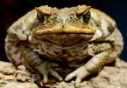
Medieval cures
Dried toads
A popular suggestion among doctors was to put a dried toad onto the victim’s plague boils. A doctor at the time wrote instructions:
“Toads should be thoroughly dried in the air or sun. They should be laid on the boil. Then the toad will swell and drain the poison of the plague through the skin to its own body. Once the toad is full, it should be thrown away and a new toad applied to the boils.”

Slide 13
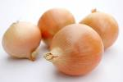

Figs and Cooked onions
Figs and onions could be used as a cure. A medieval sufferer wrote about this treatment: "The swelling should be softened with figs and cooked onions mixed with yeast and butter. When they are open they should be treated with the cure for ulcers. I developed a fever with a swelling in the groin. I was ill near on six weeks. When the swelling had ripened and had been treated in the way I prescribed, I escaped, by God's Grace".

Slide 14


Pestilence potion
Some people made up their own pestilence medicine as a cure for plague. the instructions were: “roast the shells of newly laid eggs. ground the roasted shells into a powder. chop up the leaves and petals of marigold flowers. Put the egg shells and marigolds into a pot of good ale. add treacle and warm over a fire. the patient should drink this mixture every morning and night.”

Slide 15
Bleeding, sweating, vomiting
These cures were linked to the idea that the disease was caused by the four body humours (fluids) becoming unbalanced. To bleed a patient the veins leading to the heart should be cut open, and as they bleed, the disease should leave the body, through the fluid. An ointment of clay and violets should then be applied to the place where the cuts were made. Sweating and vomiting should also allow the plague to leave the body through the fluid.

Slide 16
Lancing the buboes
This involved the plague swellings (buboes) being cut open to allow the disease to leave the body. A mixture of tree resin, roots of white lilies and dried human excrement would then be applied to the places where the body had been cut open.
Vinegar and rose water
This treatment required someone with the plague to be put to bed and washed all over with a mixture of vinegar and rose water.
Live Hens
There were some more superstitious attempts at cures. For example, putting a live hen nest to the place of swelling to draw out the pestilence from the body. To aid recovery after this, victims were to drink a glass of their own urine every day.

