Slide 1
Feudal Japanese Society

Slide 2
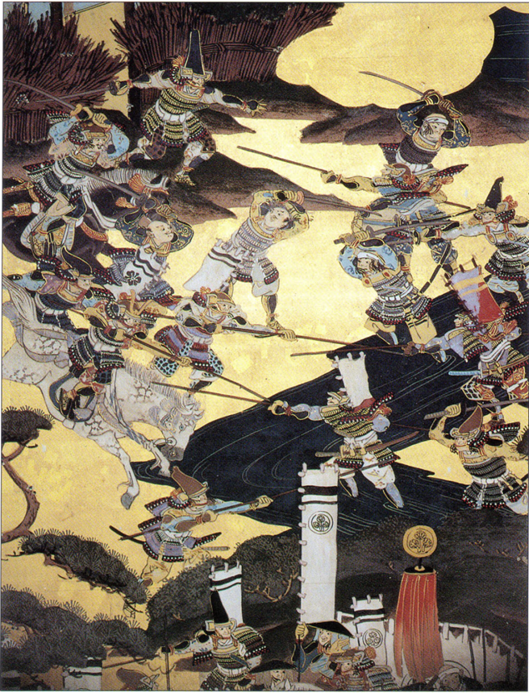
The Rise of Feudalism
Historians believe that three factors led to the rise of feudalism in Japan during the twelfth century ce.
These were the spread of large rural estates called shoen, the rise of the samurai warrior class and the establishment of the Kamakura bakufu by
Minamoto Yoritomo in 1185

Slide 3
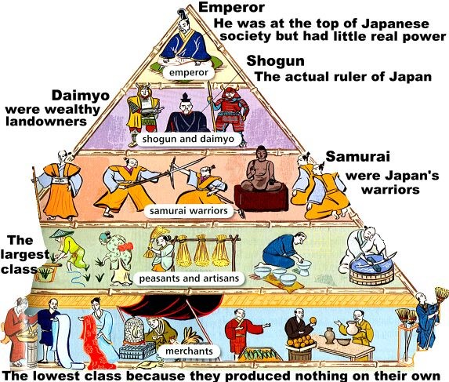
Feudal Japan

Slide 4
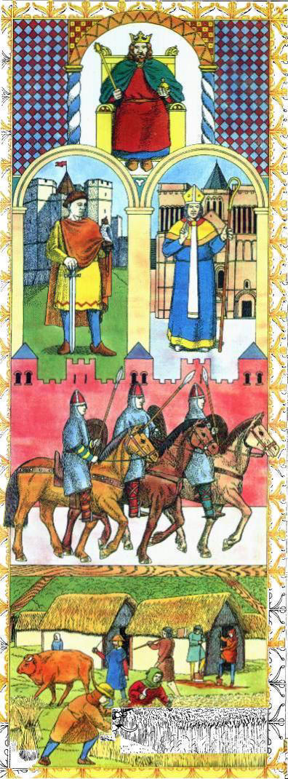
European Feudalism
King
Barons & Bishops
Knights
Peasants

Slide 5
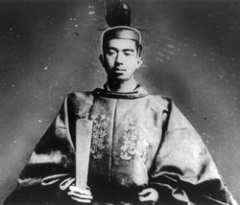
The Emperor
The Emperor and the imperial family had the highest social status. He was a figurehead, a leader in name only. He was the religious leader, but had little political power, and in reality was under control of the shogun's clan. Economically, the people of all other classes of society provided for the Emperor and his court.

Slide 6
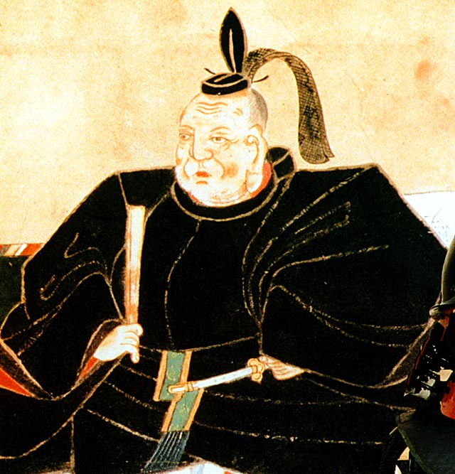
The Shogun
The shogun was the military leader of the most powerful of the Emperor's clans. The clans often fought to acquire this high social status. The shogun was the actual political ruler. He had a high social status and those of the other classes provided for his economic needs in return for protection and privileges (e.g., a small portion of land, some of the produce of the land).

Slide 7
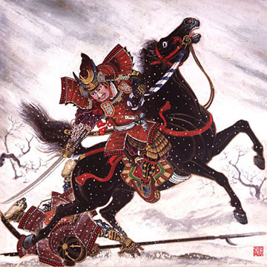
The Daimyo
The daimyos were the shogun's representatives. They ran the estates according to the shogun's rules. Their swords were their most valuable possessions because they were required to use them often to demonstrate their loyalty to the shogun. They had high social status as members of the warrior class. They lived in huge castles surrounded by moats.

Slide 8
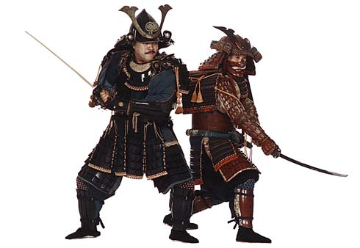
The Samurai
The samurai were professional warriors of the military aristocracy. They were loyal to the shogun and daimyos, in whose castles they resided. Their position gave them fairly high social status, but little political power. Their economic needs were met by lower classes similar to the arrangement with the daimyos and the shogun.
The ronin were wandering samurai who had no daimyos. They worked as body guards for rich merchants or as paid soldiers during civil war. They had low social status, no political power and depended on others for their economic well-being.

Slide 9
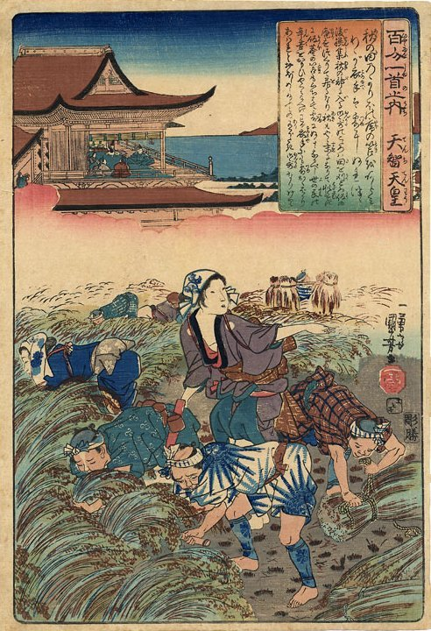
The Peasants
The peasants included farmers and fishermen. They had very low social status, no political power and were very poor. They were valued because they produced the food for all other classes, and often made the material for clothing. The peasants paid taxes to the daimyos and shogun in the form of rice and work. Often peasants starved when they had to give up more than two-thirds of the year's crops to the upper classes in return for being able to remain on the land.

Slide 10
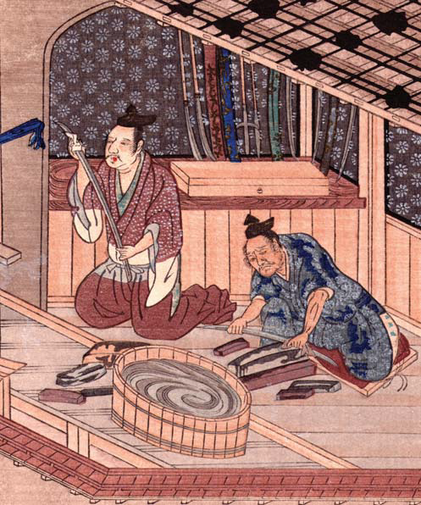
The Artisans
The artisan crafted a variety of products including art, cooking pots, fish hooks, farm tools, utensils, ship anchors and swords. The artisans, who were well-known for their exceptional swords, were highly respected. However, on the whole, this class was not as respected as peasants because they did not produce food.

Slide 11
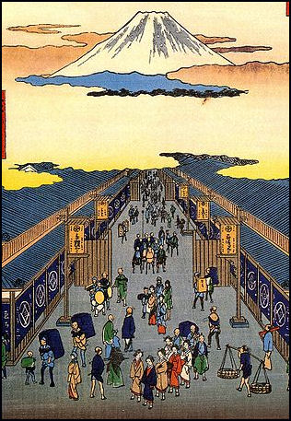
The Merchants
The merchants were of very low social status and seen as unimportant because they produced nothing of value and lived off the efforts of others' work. So low was the respect for these sellers that, often, they were made to live in separate locations and not allowed to mix with other classes except to do business.

Slide 12
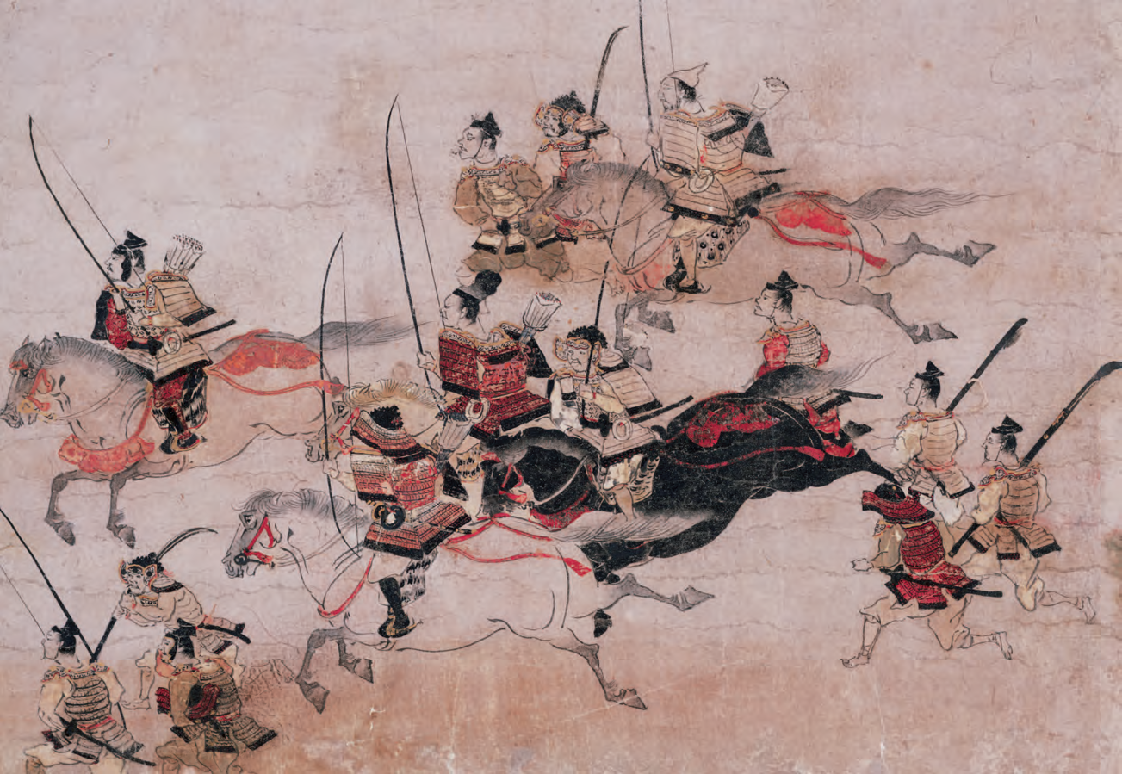
The Shoen
Samurai in battle scene,
fourteenth-century handscroll.
Held at Seattle Art Museum

Slide 13
Shoen were large rural estates that were free from tax. Peasants who lived on a shoen were taxed and governed by the governor (or owner) of that shoen. Initially the emperors of Kyoto gave shoen to Buddhist monks as gifts. The emperors created the shoen during the Heian period (794–1185). This meant that the monks could grow rice on their shoen and not pay tax. They could also have peasants working for them whom they could collect tax from.
The peasants also contributed to the spread of shoen. Many peasants voluntarily gave up independent control of the land they cultivated and asked local governors to include it in their shoen. This benefited the peasants because once a governor had accepted a peasant’s land into his shoen he was then obliged to protect the peasant against bandits and during times of civil strife.
There became more and more shoen in Japan. This had consequences for the emperors who ruled Japan. They weren’t getting as much money from tax as they used to
They didn’t have authority over large portions of the population, since the peasants who worked on the shoen’s were ruled by the shoe governors who owned the shoen.
Shoen governors gained power through this independence.

Slide 14
Shoen in Port Lincoln?
Your Activity
Work in pairs to imagine what it would be like if there were Shoen in Port Lincoln.
Think about the following:
What would change?
What would be good?
What would be bad?
How would it effect you?

