Slide 1
FEUDALISM
MEDIEVAL SOCIAL ORDER

Slide 2
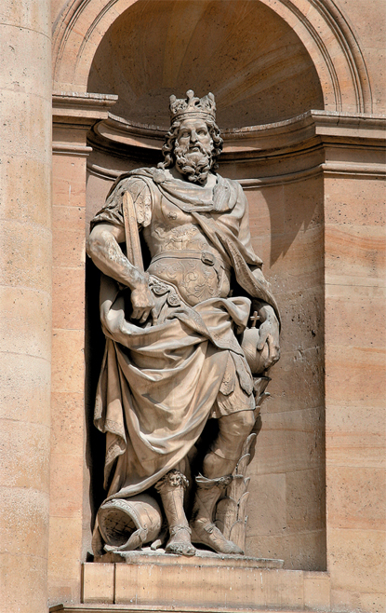
CHARLEMAGNE
Source 4 A statue of Charlemagne that stands in Paris. Charlemagne bears the traditional symbols of a medieval European king: orb, sceptre and crown.
In 800 CE Charlemagne, king of the Franks, gave land to churchmen and wealthy families in return for their support in running the empire.
This method of ordering society is called feudalism. Although Charlemagne's feudal system was based on practices that had existed for centuries, it is in this period that strong evidence first identifies a clear feudal system in Europe.
It took hundreds of years for feudalism to spread. Some European countries never adopted the system, and some Asian societies, such as Japan, developed their own particular feudal system.

Slide 3
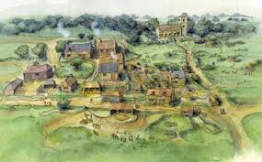
VILLAGES
There were few cities or towns in early medieval Europe.
Most communities were based around small villages. Most people who lived in the villages were peasants — poor farmers who worked the surrounding land.
Most of the wealth therefore came from the produce generated by the peasants, who were by far the biggest social class and made up about 90 per cent of the population.

Slide 4
FEUDALISM
Under feudalism, the monarch was the owner of all land in a kingdom.
The next most powerful class consisted of feudal lords, who were the big landowning nobles. In return for the right to land and control over peasants who worked it, these nobles (or tenants-in-chief) were required to give the king their loyalty, fight for him in wars and provide him with a proportion of taxes collected from the peasants.
Below the nobles were the knights (or sub-tenants). In return for land, they gave loyalty to their lord, fought for him and provided him with taxes from their peasants.

Slide 5
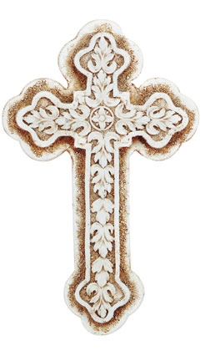
CHURCH
The monarch also gave land to the clergy. In western European countries such as England, the clergy swore loyalty to the Pope in Rome over their king.
However, they also supported the feudal system by accepting the monarch and the lord as God's earthly representatives.
Well-educated clerical advisers were often assigned to the king's service and helped keep social order.

Slide 6
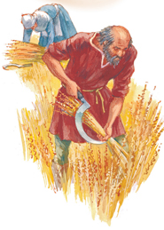
Maintaining the social order
Source 3 Medieval farmers had nothing like the huge mechanical harvesters farmers use today to harvest wheat. They used curved blades called sickles and long-handled scythes. It was back-breaking work, as it took a long time to harvest a field of grain by hand.
Feudalism was an effective way to tax the peasants and maintain social order. Sometimes, however, the monarch came into conflict with the clergy when his interests ran against those of the Pope. Lords might also band together and overthrow the monarch they had pledged to support.
Rebellion by the peasants could threaten both king and nobles, but it happened rarely. One of the most serious occasions was the Peasants' Revolt in England in 1381, when the king, Richard II, was himself besieged by armed peasants. However, neither this nor any other peasant revolt during the Middle Ages succeeded in overthrowing the Crown.
Towards the end of the Middle Ages, towns and cities based on trade began to grow. The rich merchants who ran them could afford to defy or ignore the king and his lords. They could even afford to hire their own knights to protect their interests.

Slide 7
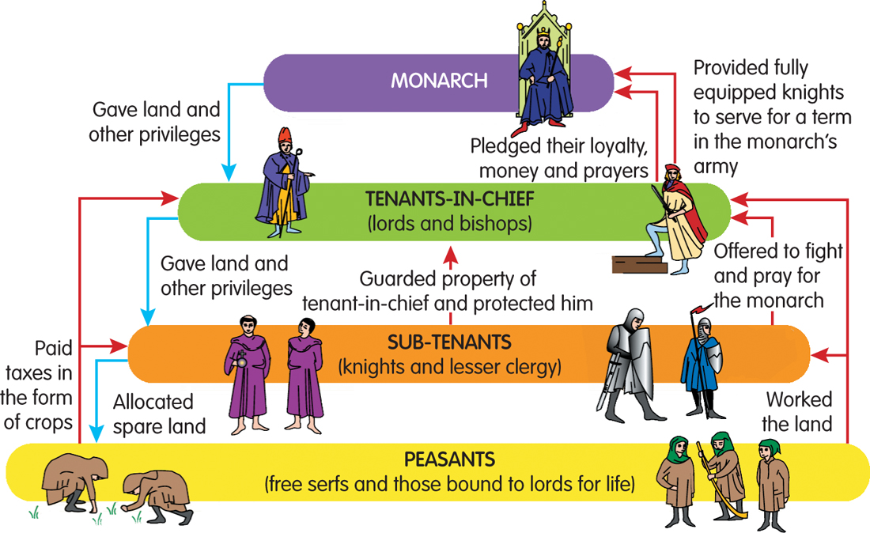
FEUDAL PYRAMID
Source 2 How society in Europe was organised under the feudal system

Slide 8
OATH OF ALLEGIANCE
Source 1 An oath taken in 1127 by knights and clergy to serve William, Count of Flanders, at Bruges, Belgium. The bond between them was sealed when William touched each man with a sceptre at the end of the ceremony.
I promise by my faith that from this time forward I will be faithful to Count William and will maintain towards him my homage entirely against every man, in good faith and without deception.

Slide 9
QUESTIONS…..
WORD VERSION OF QUESTIONS IS ON MOODLE
EXPLANATION AND COMMUNICATION
When is it believed that Charlemagne introduced the principles of the feudal system to his empire?
Under feudalism, who was the ruler and owner of the land?
Under feudalism, who were the tenants-in-chief?
Apart from the king, to whom did the clergy swear loyalty?
Which serious revolt broke out in England in 1381?

Slide 10
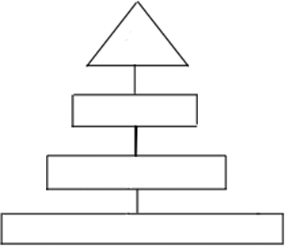
COMPLETE THE PYRAMID

