Slide 1
Illuminations are in many hand-made manuscripts created during the Middle Ages. (The term “manuscript” translates from Latin as “made by hand.”)
They were highlighted in gold and silver leaf and painted in bright colours, so there appeared to be a light within-thus came the term “illumination”.
Monks transcribed and decorated illuminated manuscripts. Their work was carried out in monasteries all over Europe in specialized rooms called scriptoria. Scriptoria's were not the height of comfort; conditions were often cramped, cold, and dark.

Slide 2
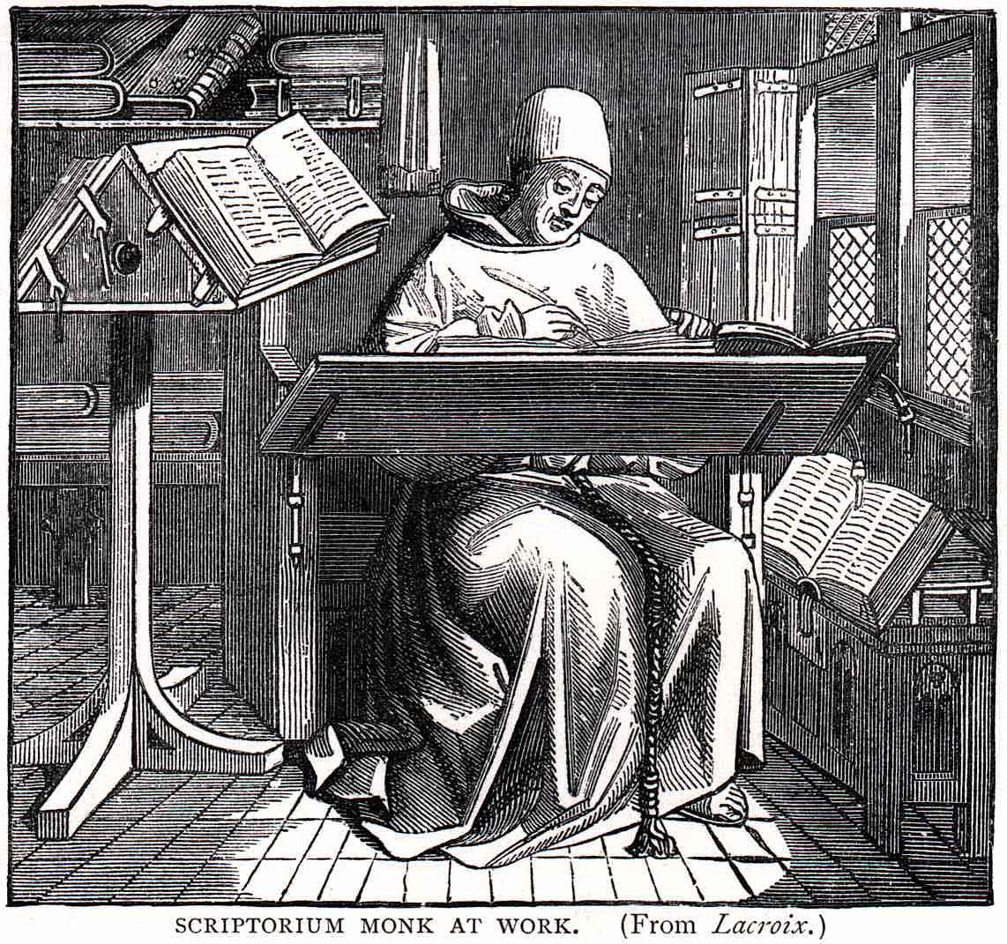

Slide 3
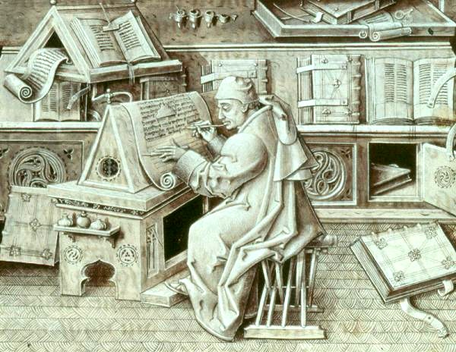

Slide 4
The monks painstakingly prepared pigments as well as parchment and vellum for their work, (as paper had not yet been developed), and their work was very specialized.
One group produced parchment and vellum, a second group decorated the manuscripts with designs and paintings known as miniatures (or illuminations), another did the writing, and the last group bound the pages into books.

Slide 5
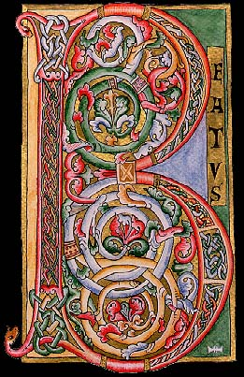

Slide 6
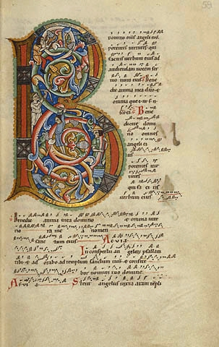

Slide 7
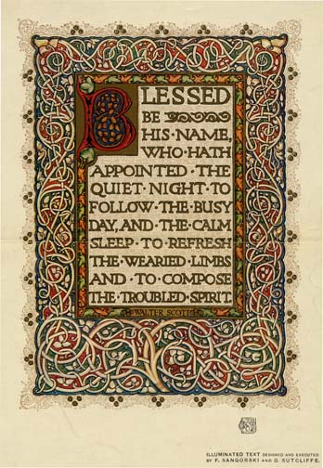

Slide 8
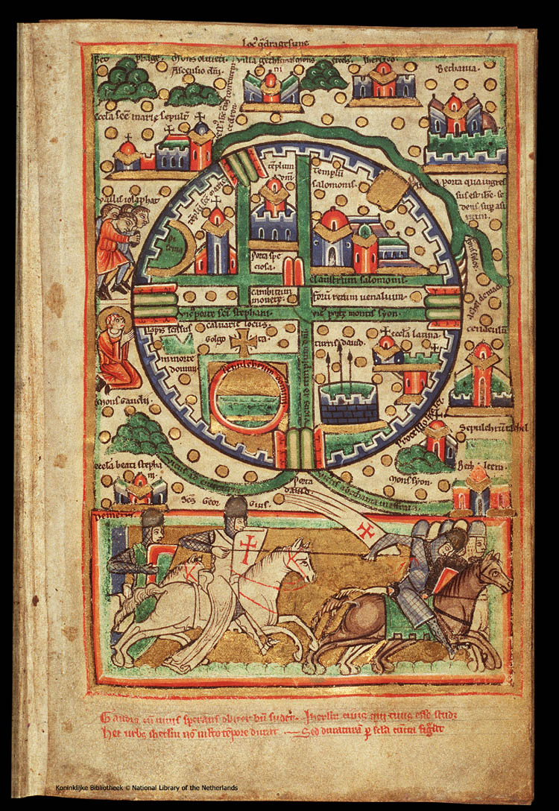

Slide 9
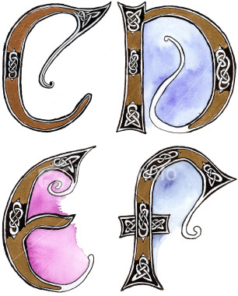

Slide 10
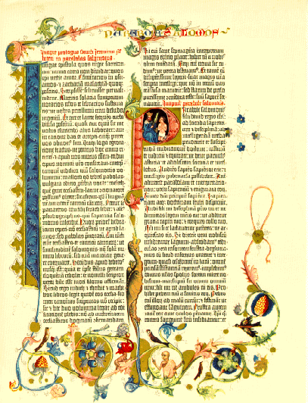

Slide 11
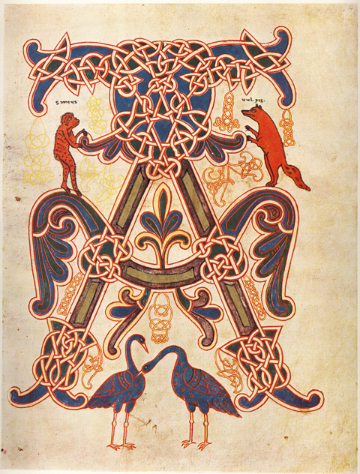

Slide 12
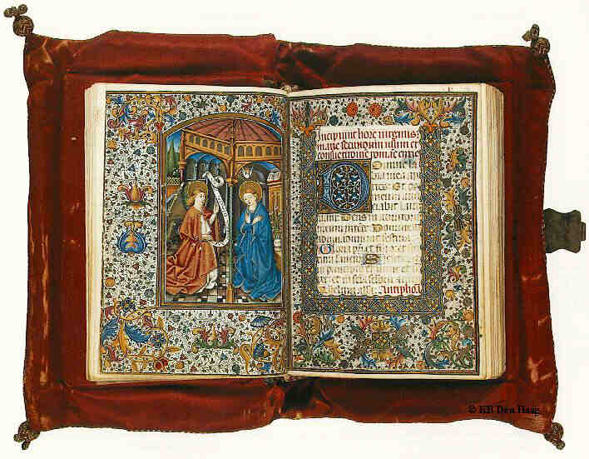

Slide 13
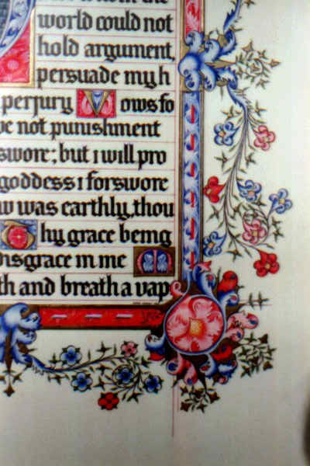

Slide 14
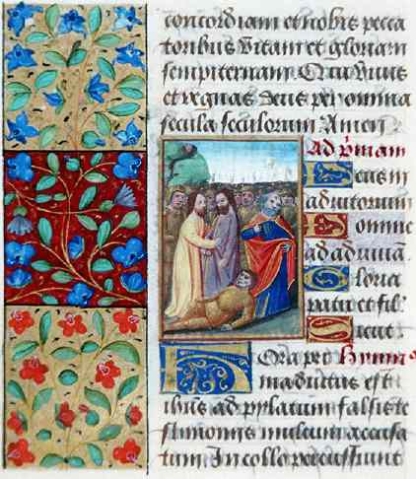

Slide 16
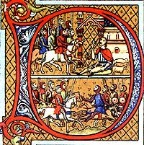

Slide 17
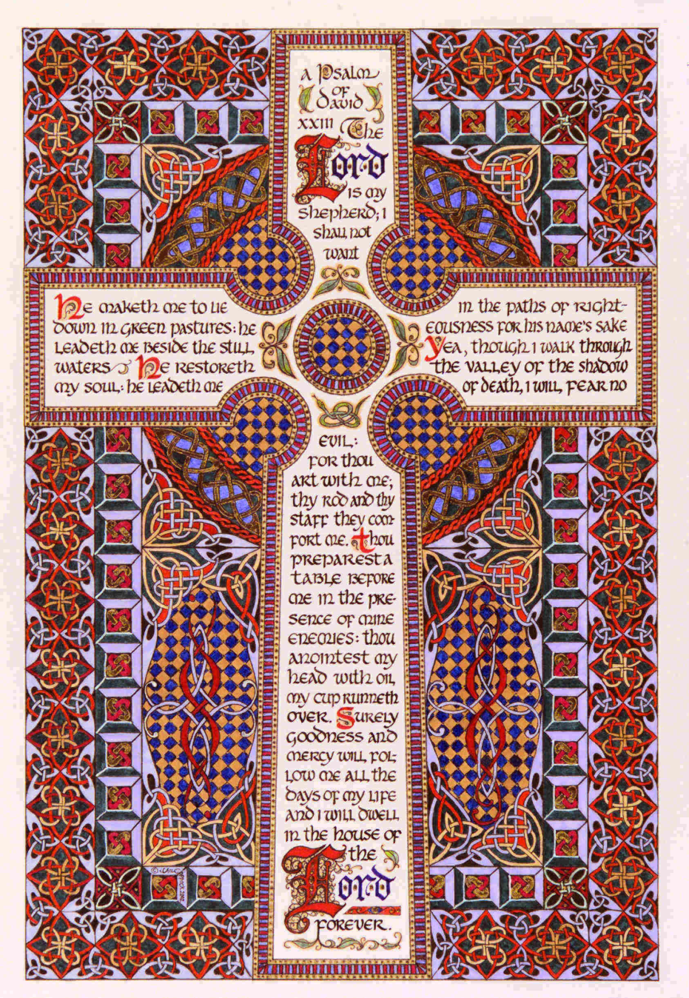

Slide 18
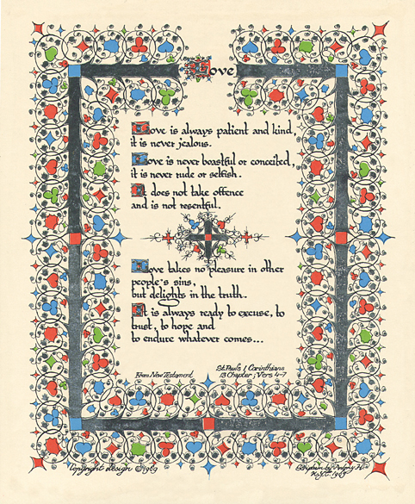

Slide 19
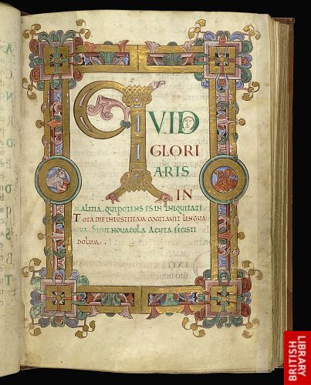

Slide 20
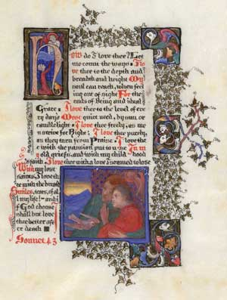

Slide 21
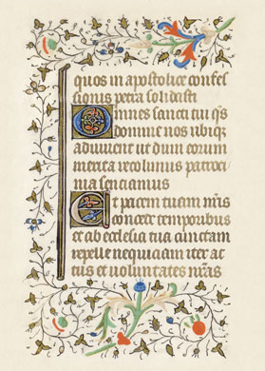

Slide 22
Your task is to create a bookmark using the style and messages that were used in the Medieval Illuminations. The message should relevant and reflect you and your personality/beliefs. The artwork needs to be detailed and intricate and if possible reflect the message used .
See the Rubric on Moodle to view the marking criteria

Slide 23
"Wheresoever you go, go with all your heart."....Inspirational Quotes by (Confucius)
"I have not failed. I've just found 10,000 ways that won't work."....by (Thomas Alva Edison)
"If you don't run your own life, somebody else will."....Inspirational Quotes by (John Atkinson)
"The important thing is to not stop questioning. "....Inspirational Quotes by (Albert Einstein)
Never look down on anybody unless you’re helping him up....Inspirational Quotes by (The Reverend Jesse Jackson)
Practice random acts of kindness and senseless acts of beauty....by Adair Lara.
Enjoy the little things in life, for one day you may look back and realize they were the big things....by (Antonio Smith).
"Failure is taking the path that everyone else does, success is making your own path."....Inspirational Quote by (Unknown).
"Success is determined by how determined you are to succeed."....Inspirational Quotes by Unknown.
"The things you fear are undefeatable, not by their nature, but by your approach."....Inspirational Quote by Jewel.

Slide 24
In the Midst of movement and chaos, keep stillness inside of you. -- Deepak Chopra -- When you reach for the stars, you may not quite get them, but you won't come up with a handful of mud either. -- Leo Burnett -- What lies behind us and what lies before us are small matters compared to what lies within us. - Ralph Waldo Emerson - Don't judge each day by the harvest you reap, but by the seeds you plant. - Robert Louis Stevenson - Impossible is a word to be found only in the dictionary of fools. If you're going through hell, keep going. - Sir Winston Churchill -

