Slide 1
Industrial revolution

Slide 2
The Industrial Revolution, which began in England, was a period in the late 18th and early 19th centuries when the life of ordinary people was changed dramatically forever. It was a time of numerous inventions, so industry developed so fast that society could barely keep up.
Before the Industrial Revolution, life for most people in England was a farming and rural lifestyle. Communications and travel were limited. Manufacturing was done by natural means, such as windmills. Life was hard, and people worked hard to pay the rent and put food on the table. Education was not available for ordinary people.

Slide 3
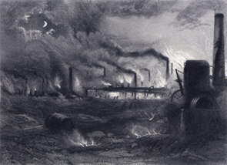
However, there were major developments and inventions in agriculture, manufacture and travel that eventually spread throughout Europe and North America.
Industry and manufacturing that was once all by hand could now be done by machine. It all started with the textile industry and spread to other products.
Factories were built and steam powered machinery increased the manufacture. Enormous amounts of coal had to be burned to make enough steam to power the machines. Increased products meant that more goods needed to be transported, so canals were built, and roads and railways improved.

Slide 4
Everyday life
The effects of all this rapid change on society was enormous. More and more people left the land and went to towns and cities to work in factories. The growth of the towns couldn't keep up with the number of people pouring into them, and so housing was hard to get and people lived in slums in appalling circumstances.

Slide 5
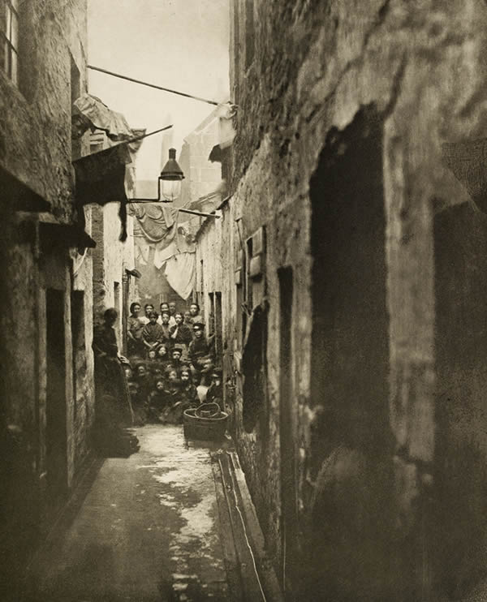
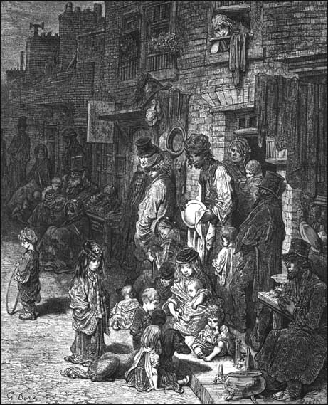

Slide 6
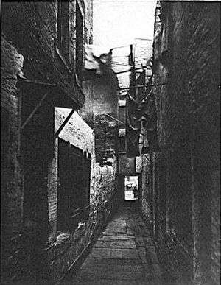
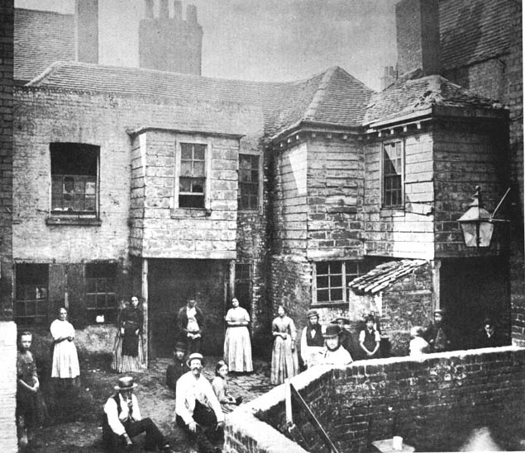
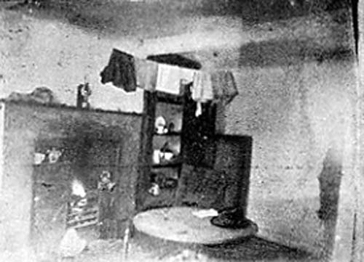

Slide 7
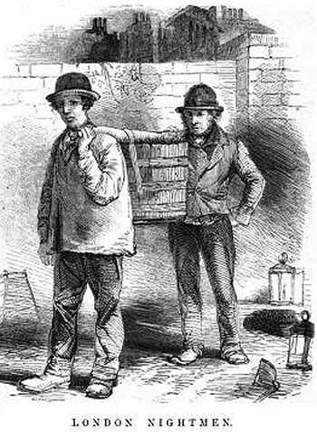

Slide 8
What would London have been like in the 1700’s?
Read through the handout to find out.
Create a ‘word cloud” to help explain the conditions by typing in important words and sentences
http://www.wordle.net

Slide 10
Work houses

Slide 11
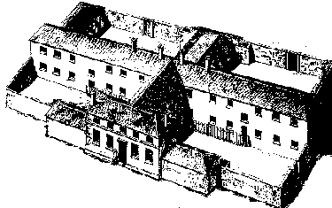
WHAT WAS A WORKHOUSE?
If you were poverty-stricken, or an unwanted orphan, or an impoverished widow, if you were too old to work, or if you were on the tramp, or you were sick or deranged, you could end up in the dreaded union workhouse. The workhouse, sometimes referred to as the Bastille, was a ruthless attempt in 19th century England to solve the problem of poverty.
A plan of a workhouse for 200 inmates
A type of workhouse sometimes seen in rural areas. Note the yards for men, women & children

Slide 12
WHAT WAS IT LIKE IN THE WORKHOUSE?
Life was meant to be much tougher inside the workhouse than outside, and the buildings themselves were deliberately grim & intimidating - they were designed to look like prisons. They were full of illness & disease brought about by over-crowding & the starvation diet. When you were admitted to the workhouse, you were stripped, searched, washed & had your hair cropped.
You were made to wear a prison-style uniform. Women were at all times kept separate from the men, including their husbands. Children were kept separately from adults - even from their own parents. A well known story tells how a labourer gave notice to leave the workhouse with his wife & children - only to be told: "You cannot take your wife out. We buried her three weeks ago". In one instance, a girl aged 15 years died in the workhouse. Her records showed that she was born in the workhouse & had never been outside the place.

Slide 13
Child labour

Slide 14
Charles Dickens captured life in England during the Industrial Revolution the novel “Oliver Twist set in early 1800’s
Watch “Oliver Twist” 3.00-10.00

Slide 15
Factories were run for profit. Any form of machine safety guard cost money. As a result there were no safety guards. Safety clothing was non-existent. Workers wore their normal day-to-day clothes. In this era, clothes were frequently loose and an obvious danger.
Children were employed for four simple reasons :
there were plenty of them in orphanages and they could be replaced easily if accidents did occur
they were much cheaper than adults as a factory owner did not have to pay them as much
they were small enough to crawl under machinery to tie up broken threads
they were young enough to be bullied by 'strappers' - adults would not have stood for this

Slide 18
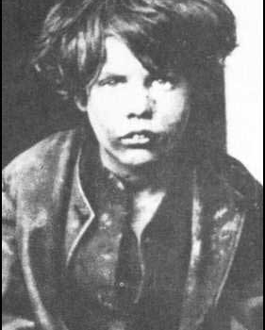
Give out information about life of children during Industrial Revolution
Write a letter from the viewpoint of a child during the Industrial Revolution in England. Use the information on the sheets to help.
I will twitter some useful web links
(twitter – ssplhs)

Slide 19
Overcrowded prisons
Crime
London’s population doubled between 1750 and 1770. This rapidly rising birth-rate meant that suddenly England had a workforce made up of very young people who had no hope for the future. There weren’t enough jobs to go round, and the only way people could survive was to steal.
More and more people were turning to crime, and there seemed to be no way to stop them.
Capital punishment
The government began sentencing criminals to death for almost any offence.
They hoped that capital punishment would frighten people enough to make them think twice before committing a crime. A murderer, a thief, or someone who cut down another person’s shrubbery, could all get the same sentence.
Thousands of people were hanged for crimes that would only get them a fine today.

Slide 20
Hulks on the river
Warship gaols
The prison hulks were a temporary measure that lasted for 80 years. To ease overcrowding in the gaols, the authorities also decided to imprison convicts in the hulks of old warships moored on the Thames. Many prisoners served their entire sentence on the hulks. Others were housed there until a space could be found on a transport ship to Australia.

Slide 22
Conditions on board the floating gaols were appalling. The standards of hygiene were so poor that disease spread quickly. The sick were given little medical attention and were not separated from the healthy.
Two months after the first convicts had been placed on board the hulks, an epidemic of gaol fever (a form of typhus spread by vermin) spread among them. It persisted on and off for more than three years.
Dysentery, caused by drinking brackish water, was also widespread. At first, patients, whatever their state of health, lay on the bare floor.
Later they were given straw mattresses and their irons were removed.
Death and disease
Mortality rates of around 30% were quite common. Between 1776 and 1795, nearly 2000 out of almost 6000 convicts serving their sentence on board the hulks died.
Many of the convicts sent to New South Wales in the early years were already disease ridden when they left the hulks. As a result, there were serious typhoid and cholera epidemics on many of the vessels heading for Australia

Slide 23
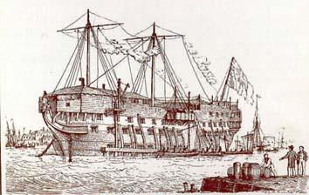
Life aboard the 'Retribution'
James Hardy Vaux described the conditions on the hulk Retribution:
“There were confined in this floating dungeon nearly 600 men, most of them double ironed; and the reader may conceive the horrible effects arising from the continual rattling of chains, the filth and vermin naturally produced by such a crowd of miserable inhabitants, the oaths and execrations constantly heard amongst them…. On arriving on board, we were all immediately stripped and washed in two large tubs of water, then, after putting on each a suit of coarse slop clothing, we were ironed and sent below; our own clothes being taken from us…. “

Slide 24
A tough life
The living quarters were very bad. The hulks were cramped and the prisoners slept in fetters. The prisoners had to live on one deck that was barely high enough to let a man stand up. The officers lived in cabins in the stern.
The conditions on board were often worse than places like Newgate. Attempts by any prisoners to file away or knock off the chains around their waists and ankles led to frequent floggings, extra irons and solitary confinement in tiny cells with names like the 'Black Hole'.
Convict dress
The men were poorly dressed as well as unhealthy. They were supposed to have:
a linen shirt
a brown jacket
a pair of breeches.
But the men who controlled the ships often pocketed the money the government had given for the clothes.

Slide 25
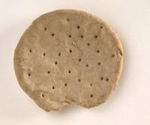
Food on the hulks
The authorities were always keen to keep down the cost of the prisons. They wanted to avoid giving prisoners a better life than the poor had outside the hulks.
The quality of the prisoners' food was therefore kept as low as possible. The monotonous daily meals consisted chiefly of:
ox-cheek, either boiled or made into soup
pease
bread or biscuit.
The biscuits were often mouldy and green on both sides! On two days a week the meat was replaced by oatmeal and cheese. Each prisoner had two pints of beer four days a week, and badly filtered water, drawn from the river, on the others.

Slide 26
American independence
It was too expensive to build more jails, and the English upper class didn’t want to have to see people suffering in chain gangs. Everyone wanted to get rid of the problem. The best idea seemed to be to take the prisoners to another country where England owned land, and leave them there. This was called transportation.
Transportation
Transportation had been used since the beginning of the eighteenth century to rid the English of their prisoners. Usually, convicts were taken to the British colony of America, but the American War of Independence (1775–1783) changed all that forever. The Americans no longer wanted to be a part of the British Empire, and were willing to fight for the right to govern themselves.
America won the war, and its new government told Britain not to send any more white convicts. The Americans preferred to use black African slaves to do the work.

