Slide 1
Japanese Geography

Slide 2
Google earth map.

Slide 3
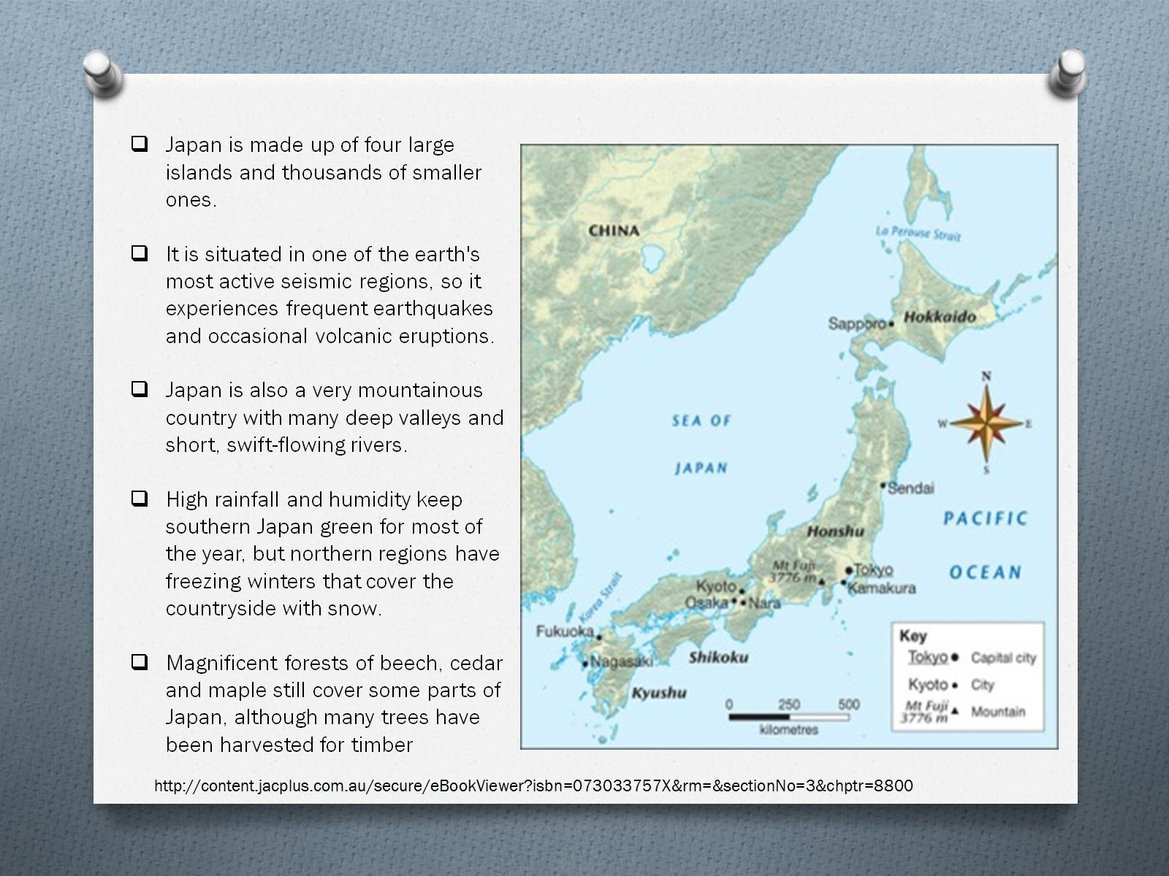

Slide 15
But what is Japan really like?

Slide 16
Assessment sheet

