Slide 1
Life in the Edo Period

Slide 2
1600-1868
Japan under military control of the Tokugawa shoguns.
Christians persecuted.
Shi-no-ko-sho organisation of society
Policy of national seclusion isolates Japan from the rest of the world.
Edo is the largest city in the world.

Slide 3
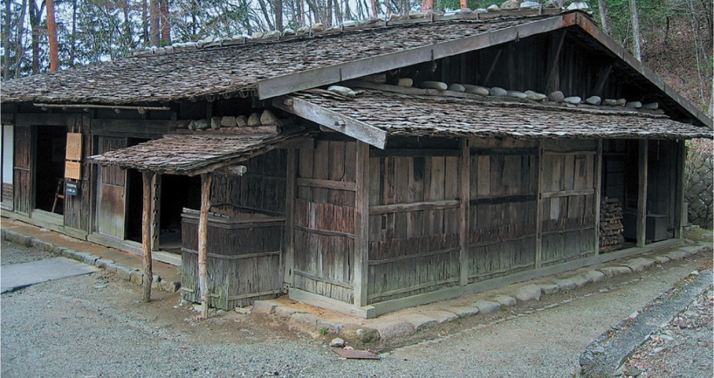
Homes of rich and poor
Merchants
Town streets were lined with narrow-fronted wooden houses and shops. Merchants and craftsmen often carried out their business from home, dividing work premises at the front of the building from living quarters at the back.
Samurai
High-ranked samurai often lived in large mansions with tiled roofs. A veranda surrounded the whole house, and the timber floors were covered with rush mats called tatami. Rooms were separated with sliding screens or shoji instead of walls.
Farmers
The homes of poor farmers often had earthen floors and shingled roofs. A large hearth in the centre of the main room was used for cooking and for warmth in winter. The owners might have a small Buddhist altar for saying prayers and honouring ancestors.
The house of a poor farmer in Hida prefecture.

Slide 4
Art and Culture in Towns
The long and generally peaceful rule of the Tokugawa Shogunate contributed to art and culture reaching a new peak in the Genroku period (1688–1704). Most people in rural areas were farmers, but townspeople or chonin had grown wealthier so they could afford more art, clothing and entertainment.
With their bustling ports, lively pleasure districts and busy markets, large towns were exciting places to live. Attending plays at the kabuki theatre was a popular pastime (see Source 4). Kabuki was a highly stylised form of theatre combining drama and dance with very elaborate costumes. The plays usually told stories of ordinary life and attracted all classes of people. About 40 per cent of the people could now read and write, so new literature was also popular.
Samurai were still bound to serve their feudal lords, but they worked as clerks or administrators rather than warriors.

Slide 5
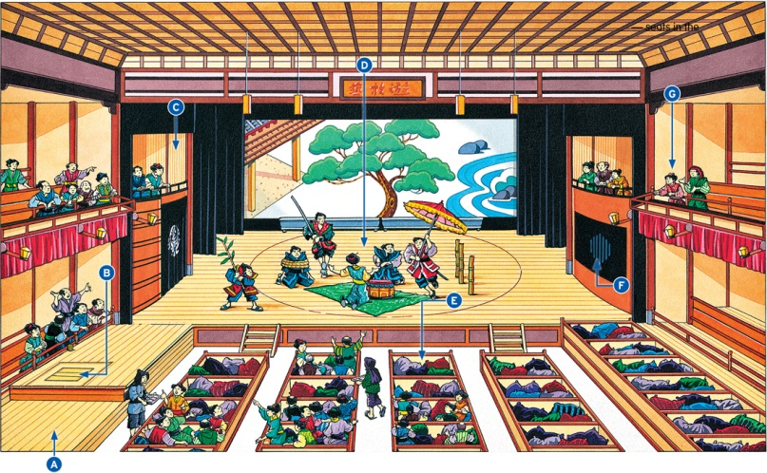

Slide 6
Source 4 A modern artist's impression of a kabuki theatre from the Edo period
A Hanamichi — a walkway leads from the stage to the back of the theatre. It is used for dramatic entrances and exits.
B Suppon — a man-powered lift-trapdoor is set in the walkway three metres from the stage. Ninjas, ghosts and monsters appear from here.
C Kuromiso — bamboo blinds on the left-hand side of the stage conceal musicians who play instruments to make the sounds of wind and rain.
D Marawibutai — the centre of the stage can revolve. This is useful for changing scenes and clearly contrasting the previous scene from the present one.
E Masuseki — these square, box-like seats can seat four people.
F Gidayuyuka (choboyuka) — this place on the right-hand side of the stage is used to hide narrators and musicians.
G Omuko — seats in the gallery on the second floor were quite cheap. Kabuki fans and experts sit here to get a good view and cheer their favourite actors.

Slide 7
Life in the Castle towns
During the fifteenth and sixteenth centuries, rival feudal lords started to build strong castles on mountains for defence in war. Later, forts on flat land were also developed into castles. Most daimyo castles were built near main roads and so towns grew up around them. Castle towns themselves had no gates or walls and were usually surrounded by open farmland and small villages. Samurai were ordered to settle in the towns and lived close to the castle itself while merchants and craftspeople lived further away.
At the start of the Edo period, there were about 200 to 250 castles in Japan. This was a smaller number than in previous periods because the Tokugawa shoguns enforced a policy of ‘one domain, one castle’ to limit the power of the feudal lords. The daimyo were forced to demolish any additional castles in their domains.

Slide 8
Forestry
The growth of cities created a huge need for timber. It was the main construction material for Japanese houses, shrines, temples and castles. Wood was also used for fuel in homes and industries. Japan had to use its own forests because traders were not allowed to import foreign timber. Many trees were cut down and so timber became scarce. Parts of Japanese cities were often destroyed by fire and replacing wooden buildings increased the demand.
The Tokugawa shogunate took action to overcome these problems. Official permission was needed for logging, and stealing timber became a serious crime. The shoguns encouraged the study of tree growth and ordered the replanting of forests. Some daimyo grew plantations on their own lands and villagers learned to raise seedlings. Although it took many years for the situation to improve, Japan gradually developed a very effective system of sustainable forest management.

