Slide 1
The Medieval Church

Slide 2
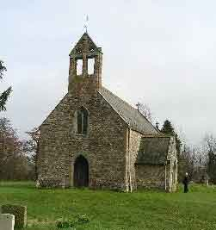
Christendom
Medieval Europe was often referred to as Christendom because just about everyone was as Christian. The Catholic church was central to people’s lives as everyone believed in God and the Devil
Every Sunday, every villager attended a service, called mass, in the church

Slide 3
Medieval people were worried about where their souls would go after death. Had they lived a good enough life to go to heaven. Or had they been sinners and so would be tortured in hell forever
Medieval people lived their lives trying to show God they were good. They could do this by giving alms ( money) to the poor, or by going on a pilgrimage- a journey to a holy site
It was also common for people to join the Church as priests, monks or nuns. They spent their lives either living in seclusion and worshipping God, or helping other.

Slide 4
Wealthy merchants and noblemen gave money to build grand churches and cathedrals to show their goodness and to please God. Knights and noble lords sometimes went on crusades to fight for God
Other people would just try to live the best lives they could by following the laws of God and the Church

Slide 5
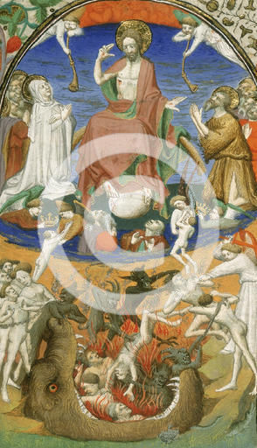
Medieval painting of hell from the Bedford Missal( medieval prayer book) 1943
What can be seen happening in heaven and hell?
Who or what are the central figures in heaven and hell
Why do you think such pictures like this were included in a prayer book?

Slide 6
The power of the church
The catholic church in the Middle Ages was very powerful
Its people were the channel by which ordinary people could find out what God expected of them
Priests held mass, preached sermons about how people should behave, heard confessions of people’s sins and told them what God wanted them to do in order to be saved from damnation in hell

Slide 7
The head of the Catholic Church
The head of the Catholic church was the pope in Rome
He was often seen as having more power than kings as his authority was directly from God
The pope could excommunicate ( banish from the church) any person- serf, noble or king
An excommunicated person could not attend mass or gain forgiveness for their sins. People feared excommunication as it meant they could go to hell for their sins

Slide 8
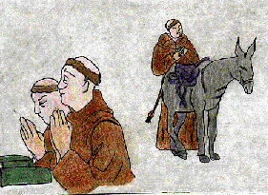
Monasteries
Monasteries were self-contained enclaves where monks chose to live a simple live of prayer and work
There were different orders of monks who followed different rules
Some monasteries, well-endowed by wealthy patrons, became powerful centres of influence

Slide 9
Monks
Monks took vows of poverty, chastity and obedience and they also promised to live a life devoted to prayer
They were referred to as ‘Brothers’
Mostly daily life in a monastery was hard. The monks ate plain food and wore rough, homespun robes called habits
Many monasteries operated under a vow of silence

Slide 10
The life of a monk was dictated by a set of rules which governed everything he did every day of his life
The earliest set of rules was devised by St Benedict in the sixth century
There were two types of monasteries; the larger ones were called abbeys, while smaller monastic houses attached to churches were called priories
The leader of a monastery was elected by monks. In an abbey he was called an abbot, and in a priory he was called a prior

Slide 11
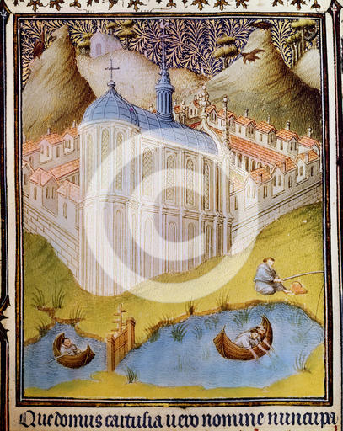
Carthusian Monks
In what everyday activities are the monks engaged?
What information does this images provide about the role and wealth of the church

Slide 12
Convents
Women could chose to become nuns and live in convents which were self supporting communities
Their lives were dedicated to God and the Church and they renounced worldly possessions and desires
As with monks there were many different orders of nuns. However, all nuns led lives that were strictly disciplined
Nuns made three vows; of poverty, chastity and obedience

Slide 13
Good works of the Church
In medieval times there were no schools, hospitals or even hotels as we know them today
All these were provided by the Church.
The priest and monks gave lessons to the local boys, teaching them to read and write simple Latin
Monks and nuns helped to feed and by monks and nuns who often possessed only a basic knowledge of medicine
Monasteries and convents also offered food and lodging to travellers and pilgrims.

Slide 14
Centres of Learning
The church house was also a storehouse of learning
In the Middle Ages, when most of the people were illiterate, monasteries were beacons of learning
In the early Middle ages monasteries were virtually the only source of books and of literacy
Although secular topics were the subject of many early writings, the great majority of early manuscripts were religious text such as the bible and book of hours, which set out prayers for each part of the day.
It was also in the monasteries that classical works of philosophy, science and literature were copied and preserved for later centuries.

