Slide 1
MILITARY RULE
Created by Sheryl Skalski : all information used directly from ‘History Alive 8 – Jacaranda ‘ unless accredited separately.

Slide 2
Fujiwara clan 600-1100
Nobles from the powerful Fujiwara clan dominated Japanese politics from the seventh century until the end of the Heian period in the twelfth century.
They controlled all the most important offices in the royal court and were governors of many provinces in the countryside
. Most emperors married Fujiwara women, and senior members of the family became regents if an emperor was too young to rule. At some stages, the Fujiwara family, rather than the emperor, ruled Japan.

Slide 3
Family rivalries
The Heian period was characterised by struggles for influence among the three most powerful daimyo clans, the Fujiwara, the Minamoto and the Taira.
After the long period of dominance by the Fujiwara, in 1068 the Emperor Go-Sanjo reduced their power by appointing members of the rival Minamoto clan to important government offices.
Go-Sanjo was the first emperor for more than two hundred years whose mother had not been a member of the Fujiwara clan.
He himself married members of the Minamoto clan, so his heirs were loyal to the Minamoto rather than the Fujiwara.

Slide 4
The struggle for power
The twelfth century was a very unstable time in Japan. The Minamoto family had become the most powerful daimyo clan in Japan, but their power was challenged by the Taira clan.
A series of rebellions, followed by civil war from 1180 to 1185, led to ultimate victory by the Minamoto family, who then proceeded to destroy the Taira clan.
A famous historical account of the civil war period, The Tale of the Heike, was written by a number of different authors and is considered one of the great works of Japanese literature.

Slide 5
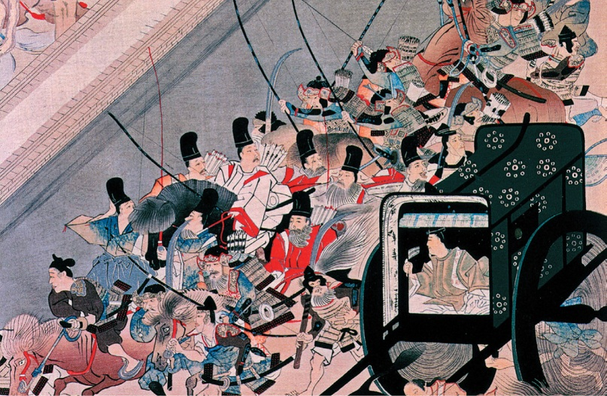
This thirteenth-century illustration shows the escape of the imperial family during civil war.
Source 1

Slide 6
The Kamakura shogunate
In 1192 the emperor appointed the head of the Minamoto clan, Minamoto no Yoritomo, as shogun, to lead the Japanese armed forces.
Yoritomo set up his government in the city of Kamakura, about 50 kilometres south of modern-day Tokyo.
The establishment of this shogunate was important because it saw real power pass from the emperor to the shogun.
It is regarded as the end of the Classical period and the beginning of the shogunate or feudal period of Japanese history.
For the next 700 years Japanese emperors were restricted to religious and ceremonial duties, while the shoguns and their samurai warriors effectively ruled Japan.
Japanese society was based on a farming economy, with a governing class of warriors and great lords who granted land to their vassals in return for their military support and total loyalty

Slide 7
Kamakura shogunate
The Kamakura shogunate lasted nearly 150 years and brought political stability to Japan.
New laws outlined the rights of the samurai and Buddhism gathered strength. It had previously been the religion of only the ruling class but now spread to the common people.
One of Japan's most famous sights, the Golden Pavilion in Kyoto, was built during this period as a Buddhist temple.
Art and culture also flourished, especially poetry, music, painting and wood sculpture

Slide 8
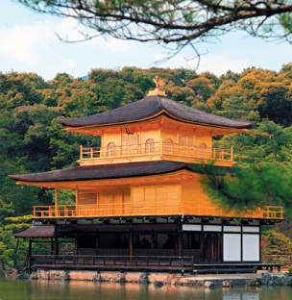
The Golden Pavilion in Kyoto
Source 3

Slide 9
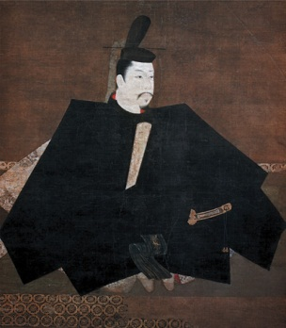
Minamoto no Yoritomo, shown in this twelfth-century artwork, became the first shogun to gain the power to rule Japan.
Source 2

Slide 10
Mongol invasions
China presented the most serious threat to Japan in the Kamakura period.
The Mongol emperor of China, Kublai Khan, demanded that Japan respect his authority and become a tributary state.
When the shogunate refused, Kublai Khan ordered his army to invade Japan. But on two occasions, in 1274 and 1281, the Mongol ships were sunk by typhoons.
The Japanese came to believe kamikaze or ‘divine winds’ protected their country.
Unfortunately, thousands of samurai who fought the Mongol attackers became angry when the shogun could not afford to pay them. They waited for an opportunity to oppose the shogunate.

Slide 11
The age of the warring states
A chance to restore the rule of the nobles and the royal court came in 1333 when Emperor Go-Daigo resisted the military government.
Samurai from the Ashikaga clan supported him and the Kamakura shogunate collapsed. However, other samurai were outraged at this challenge to their prestige and authority.
The Ashikaga clan turned against the emperor and forced him to flee into the mountains.
From 1336, the Ashikaga clan ruled Japan as shoguns for the next 237 years. It was a time of great artistic achievement, especially in theatre, literature, gardening and development of the tea ceremony.
However, the Ashikaga shoguns could not control daimyo in the provinces who fought one another to gain more land and political power.
During this age of the warring states, vassals overthrew their lords, farmers led armed uprisings and the economy was seriously weakened. Japan needed a strong leader to bring peace and order once again.

Slide 12
TASKS
Create a timeline ;
Using the dates, people and events mentioned in this PowerPoint.
You can do further research to get specific dates on those events mentioned if you want to .

