Slide 1
Religion and Philosophy

Slide 2
Religion and philosophy played an important role
in the lives of people from all the social classes in
medieval Japan. They helped people understand the
universe and also provided a connection between
the physical world on Earth and the spiritual world
inhabited by ghosts, demons and gods.
Shinto and Zen Buddhism were two of the most
important religions practised in medieval Japan.
Shinto developed in Japan, while Zen Buddhism
originated in China, where it was called Chan
Buddhism. Zen Buddhism was first introduced into
Japan in the twelfth century ce and became popular
among the samurai in the thirteenth and fourteenth
centuries. Samurai also followed Bushido, a form of
warrior philosophy.

Slide 3
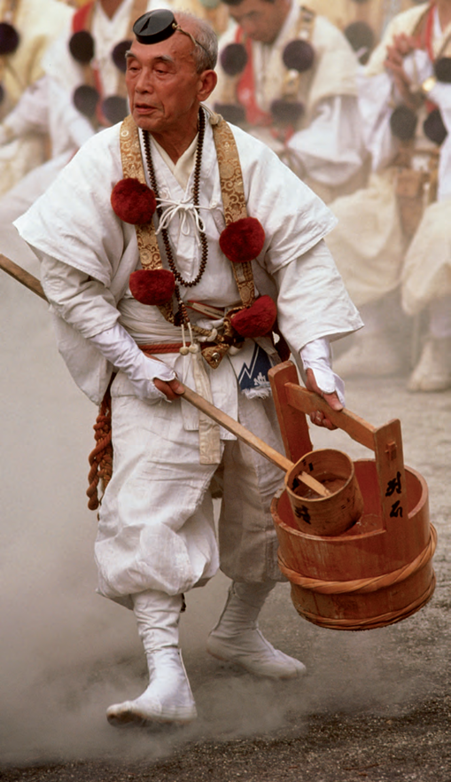
Shinto
Shinto is based on beliefs that are indigenous to
Japan, and is still practised in Japan today.
Means ‘way of the gods’
According to Shinto there exists a basic life-fore called kami.
Kami is the source of human life and of all life in nature.
Followers believe that it can not be defined by words or understood rationally as it beyond comprehension of the human mind.
It can be experienced through faith and religious practices.
Followers aim to experience kami, live a fulfilling life and bring prosperity to Japan.
Kami also means supernatural spirits or gods, such as Izangi and Iznami who created Japan.
Shinto priests believe that the sea, mountains, rocks and waterfalls have their own Kami.
Shinto priest performing a ritual

Slide 4
Zen Buddhism
Emphasises the importance of self-discipline.
The aim of Zen Buddhism is to achieve satori – the moment of enlightenment or the ‘flash of truth’ when all is understood.
It can be attained through physical discipline and mediation.
Zen Buddhists believe it is possible to attain satori through observing nature.
Samurai believed they could focus and improve their minds and become better warriors through practising Zen Buddhism.
Zen Buddhists believe enlightenment can be achieved through meditating on the trees, grass and stones in Zen gardens. The natural features symbolise the world.
Another aim of Zen Buddhism is it achieve mushin or ‘no-mind-ness-.
Mushin is the mental state of forgetting oneself and freeing oneself from fear.
Zen Buddhist monks meditating

Slide 5
Many Zen gardens, like this one in Tofukuhi Zen
temple in Kyoto, were created in medieval Japan.
Zen Buddhists believed that enlightenment could
be attained by meditating on the trees, grass,
stones and other natural features of the garden.
These natural features were also meant to
symbolise the world.

Slide 6
Your Assignment
Talk to your partner about what the following elements could represent in a Zen Garden:
Sand
Stones
Moss
Conduct some research to find out if you are correct.
Create a poster explaining the importance of nature in Japanese religion. Include information about what the different elements represent and how the gardens are used.
“One may explain water, but the mouth will
not become wet. One may expound fully on the
nature of fire, but the mouth will not become
hot. Without touching real water and real fire,
one will not know these things. Even explaining
a book will not make it understood. Food may
be concisely defined, but that alone will not
relieve one’s hunger. One is not likely to achieve
understanding from the explanation of another
… If people are not thoroughly enlightened about
their own particular minds, they will have no
understanding …”
From The Unfettered Mind, by Takuan So¯ho¯
(1573–1645), translated by William Scott
Wilson, 1986

