Slide 1
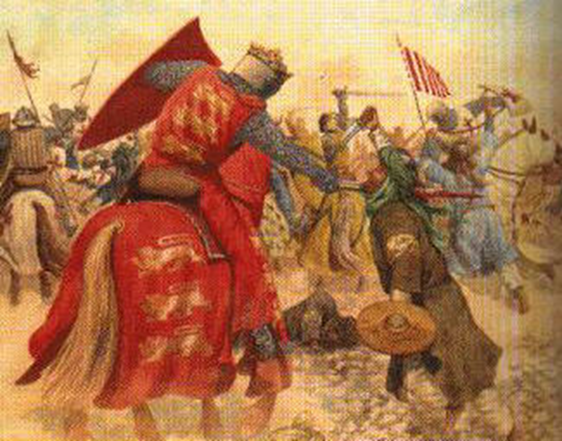
The Crusades
1095-1289

Slide 2
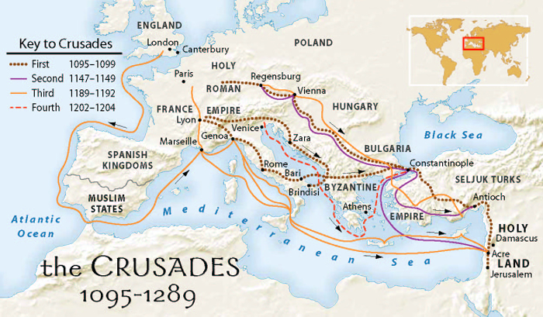

Slide 3
Medieval Europe was very much a Christian society, however the area where Jesus Christ had lived and died belonged the Muslims…..
What’s the difference between Muslims and Christians??

Slide 4
Topic | Christianity | Islam
Origin of the Name | From the Greek:christos, 'Anointed' - referring to Jesus Christ. | Derived from an Arabic word for 'submission'. Also related to the Arabic word salaam, 'peace'.
Founder | Jesus Christ (c. 4 B.C. - 30 A.D.) | Mohammed (570 - 632 A.D.)
Divisions | Three main groups: Orthodox, Protestant and Roman Catholic. | Two main groups: Sunni and Shia (The division occured due to a dispute as to the legitimate successor of the prophet Mohammed). There is also a mystical/ascetic movement in Islam known as Sufi.
Nature of God | One God, who exists in three distinct persons (The Trinity): Father, Son and Holy Spirit (Matthew 28:19). | One God (Arabic: Allah), who is not a trinity. The Islamic view of God is called strict Monotheism (Quran 112:1).
Holy Book(s) | The Bible (from the Greek:Biblos, 'books'), given by God to man. The Bible writers were inspired by God in their writings. Thus Christians refer to the Bible as the Word of God (2 Timothy 3:16). | The Quran or Koran (Arabic: 'recitation'), revealed to the prophet Mohammed over a period of about 20 years. The Quran is the final revelation given by Allah to mankind.
Jesus Christ | The second person of the Trinity and born of the Virgin Mary. "...true God from true God" (Nicene Creed) | A prophet, sent by Allah and born of the Virgin Mary, but not divine (Quran 5:17).
Jesus Christ, The Mission of | To reconcile Man to God, through his death as a sacrifice for the sins of all mankind. | To proclaim the Injil, or gospel. This gospel has been corrupted over time by human additions and alterations.
Jesus Christ, The Death of | "...For our sake he was crucified...he suffered death and was buried. On the third day he rose again...he ascended into heaven..." (Nicene Creed) | Jesus was not crucified (Quran 4:157), but was raised to Heaven by Allah (4:158).

Slide 5
How did the Crusades start……?
Up until the 11th century the Muslims allowed pilgrims to travel to Jerusalem to see where Jesus Christ had preached and been crucified
In 1095 this area was taken over by Turkish Muslims who refused to let Christian pilgrims visit Jerusalem anymore.
The Turks murdered any pilgrims who defied them.
In 1905 these murders led Pope Urban II to urge the people of Christendom to embark upon a crusade or ‘war of the cross’

Slide 6
Pope Urban II speech..
Most beloved brethren: Urged by necessity, I, Urban, by the permission of God chief bishop and prelate over the whole world, have come ……. with a divine admonition to you, the servants of God……. your brethren who live in the east are in urgent need of your help, . For, the Turks and Arabs have attacked them…...
They have killed and captured many, and have destroyed the churches and devastated the empire. ….I, or rather the Lord, beseech you as Christ's heralds……. to persuade all people of whatever rank, foot-soldiers and knights, poor and rich, to carry aid promptly to those Christians and to destroy that vile race from the lands of our friends. I say this to those who are present, it meant also for those who are absent. Moreover, Christ commands it.
"All who die by the way, whether by land or by sea, or in battle against the pagans, shall have immediate remission of sins…….. O what a disgrace if such a despised and base race, which worships demons, should conquer a people which has the faith of omnipotent God and is made glorious with the name of Christ! ……
Let those who have been accustomed unjustly to wage private warfare against the faithful now go against the infidels…... Let those who …have been robbers, now become knights. Let those who have been fighting against their brothers and relatives now fight in a proper way against the barbarians. Let those who have been serving as mercenaries for small pay now obtain the eternal reward. Let those who have been wearing themselves out in both body and soul now work for a double honor. Behold! on this side will be the sorrowful and poor, on that, the rich; on this side, the enemies of the Lord, on that, his friends. Let those who …..eagerly set out on the way with God as their guide."

Slide 7
Did it work ?
The first crusade was successful in recapturing Jerusalem and setting up a Christian holy land
These new Christian kingdoms proved difficult to defend against the Muslims.
Over the next 200 years there were several more Crusades. Not all of them were successful.
By 1291, when Acre, the last Christian city in the Holy land, was recaptured by the Muslims, the medieval people were forced to accept the fact the Holy land would remain a Muslim country

Slide 8
QUESTIONS:
Why did the medieval Christians wish to travel to the Holy land ?
What happened at the end of the eleventh century to prevent them from travelling there?
How did Pope Urban II view the Muslims and the Arabs. Use evidence to support your answer.
What did he offer Christians to persuade them to go on Crusades?

Slide 9
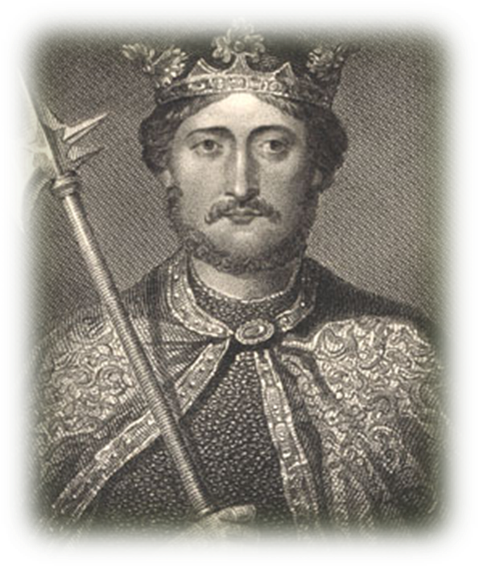
RICHARD THE LIONHEART

Slide 10
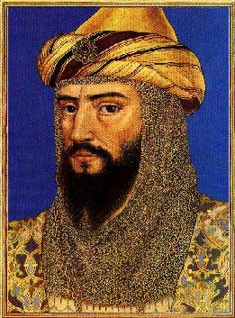
Hero of the Third Crusade
The third crusade was led by the kings of France and England and the German emperor.
The aim was to take back Jerusalem and the Holy Land from the ‘infidels’ led by Saladin*
The hero of these three Christian monarch was the charismatic King of England, Richard I , who was called ‘the Lionheart” because of his courage and bravery.
Notes:
Saladin was born into a Kurdish family in 1137 at Tikreet, and he grew up in Baalbek and Damascus. It is sometimes argued that Saladin learned from his education in Damascus to "walk in the path of righteousness, to act virtuously, and to be zealous in waging war against infidels". Saladin was able to take control of Syria, and he was pronounced sultan of both Egypt and Syria, ending a division between the two that had lasted centuries. This produced a united Arab front against the Christians and led to the events directly preceding the Third Crusade: the Frankish defeat at the Battle of Hattin and the fall of Jerusalem in 1187

Slide 11
Richard…
Richard I was born in 1157 and was the third son of Henry II of England and Eleanor of Acquitane
His older brothers both died before they could ascend to the throne, so when Henry II died the crown passed to Richard.
He was a popular king because of his knightly qualities- hence his nickname-but the truth is that over his ten year reign , from 1189-1199 he only spent six months in England and complained that it was ‘cold and always raining’ and he could not even spend English.
When the news reached Europe that Jerusalem and Acre had fallen, Richard was quick to take up the challenge of a crusade.
Historians speculate that he had three main reasons for taking up the cross- to take part in the adventure of war, to have his name immortalised by the bards and troubadours of the time, and to ensure his place in heaven.

Slide 12
Did he succeed ?
The German emperor, Frederick, was drowned on his way across Europe to join the Crusade and Phillip II of France went home after quarrelling with Richard.
Richard was left to lead the Crusades on his own.
His clever battle tactics and strategies enabled him to successfully end the siege of Acre, but without his allies he was unable to continue to Jerusalem.
He was forced to return home, despite only being a few miles from the holy city.
He vowed never to set eyes on Jerusalem as he believed that God had ordained that he should not be the one to conquer it.
Notes:
Holy Roman Emperor Frederick Barbarossa drowned while crossing a river in Turkey on horseback

Slide 13
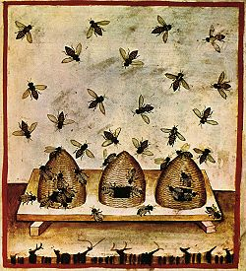
One of the most unusual military manoeuvres ever was performed in 1191, during the third Crusade, when Richard the Lion-Hearted captured the city of Acre.
The inhabitants were barricaded inside, so King Richard had his soldiers throw 100 beehives over the walls. The people in the fortress surrendered immediately.

Slide 14
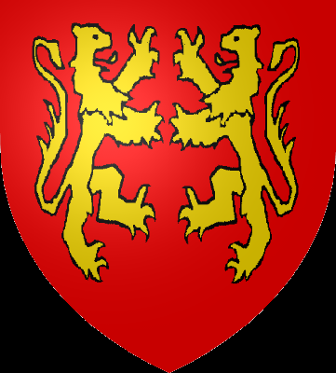
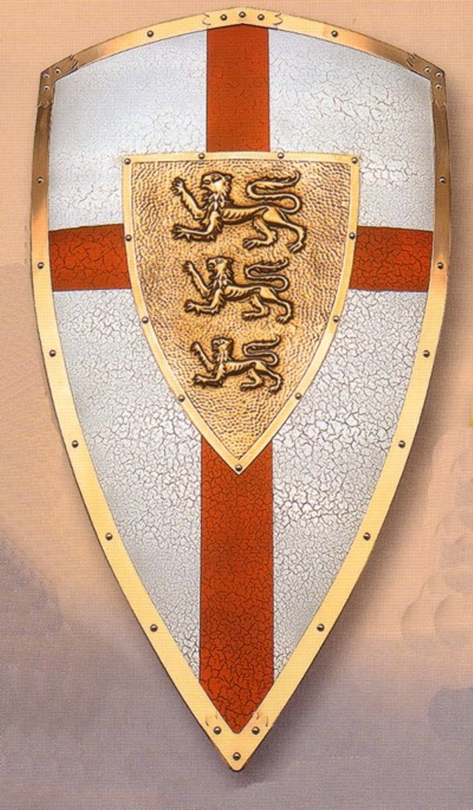
What to the colour and symbols mean on each shield? (refer to shields handout)
Which shield do you think Richard used after his crusade? Explain your choice.
These two shields were similar in style to those used by Richard before and after the crusades.
Notes:
The first Great Seal of Richard, used during the crusading period of his reign, represents him with a single rampant lion on his shield. But as the lion faces the center of the shield, of which only half is visible, there has been conjecture that there was another lion on the hidden half, and consequently Richard I has been credited with the Arms of two gold lions combatant ( facing each other fighting) on a red field
On his return from the crusade, Richard adopted the three lions “passant guardant” as his Coat of Arms and these have been the Royal Arms of England
Rampant = standing up
Guardant = standing up ( guarding)

Slide 15
Impact of the Crusades.
Weakening of the Feudal System
New Ideas
Islamic contributions to Medieval Europe

Slide 16
Weakening of the Feudal System
By the time of the last crusade at the end of the thirteenth century, the medieval feudal system that had worked so well for William the Conqueror and other European rulers was no longer as strong a force because….

Slide 17
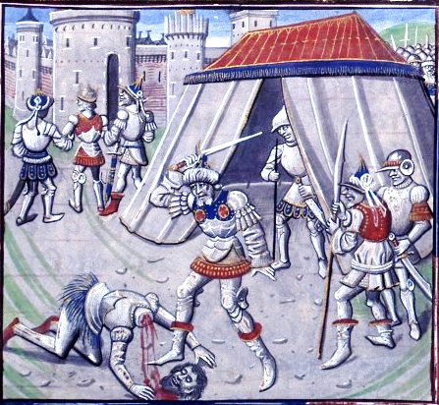
Kings were stronger
Kings became stronger, as many knights and noblemen were killed while on crusades, and so countries as they were began to change.

Slide 18
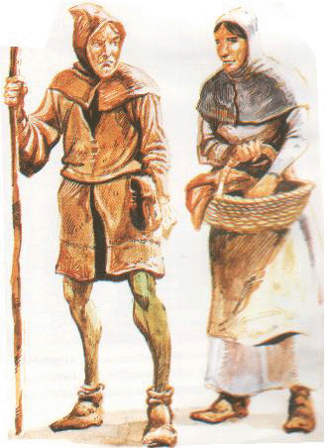
Serfs gained freedom
Serfs who had been on crusades gained a new freedom on their return

Slide 19
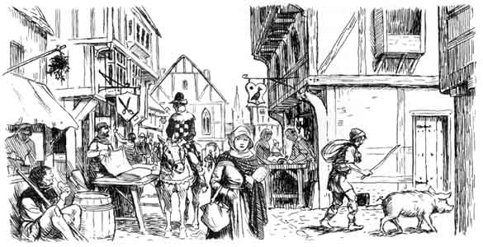
New Towns
New independent towns came into existence, as lords had often encouraged towns to buy their freedom in order to raise money for the crusades.

Slide 20
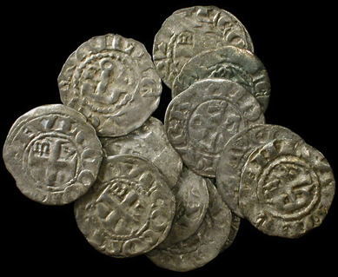
Money
These new towns became more involved in trade, so the use of money rather than barter increased, and a new merchant class was formed that had no place in the old feudal system.

Slide 21
New Ideas
The Crusades brought back many new goods and ideas that changed the way people lived…….

Slide 22
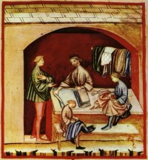
Luxury goods
Luxury goods such as silks, spices and carpets-wealthy nobles and merchants now desired these goods in their homes, which increased trade and led to the growth of towns

Slide 23
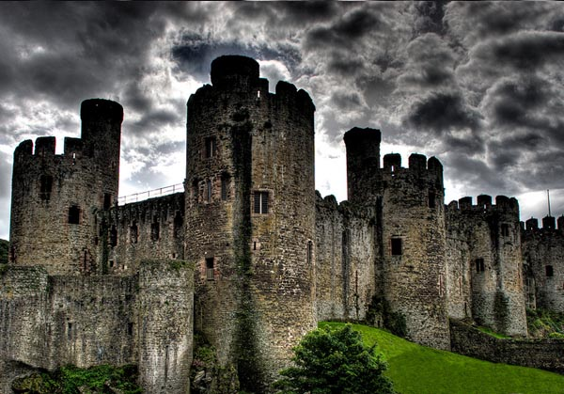
Gunpowder*
Gunpowder, which meant that castles became ineffective as means of defence.
Notes:
black powder is like the wheel, no one knows who invented it. Many have claimed the invention but it has been decided that on balance it was the Chinese or the Arabs, probably both, independently of each other. The first invention was black powder, which was developed during the period between 890 to 1050 AD, and was refined into gunpowder in Europe after the development of firearms.

Slide 24
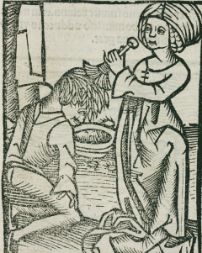
Health
Opium was brought back as a pain killer
Washing and cleanliness was more widely practised by Muslims .

Slide 25
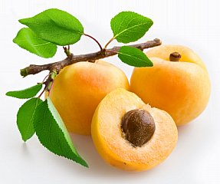
New Foods
Rice, coffee, sugar, raisins, dates and apricots which added variety to the diet.

Slide 26
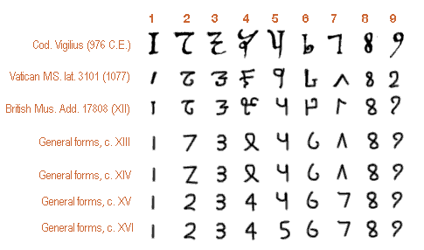
Numbers !
Arabic numbers were introduced.

Slide 27
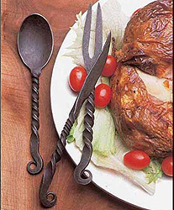
Cutlery
What’s wrong with this picture ?
Notes:
The plate…medieval plates were wooden. Ceramic plates weren't common until the late 1700’s

Slide 28
Islamic Contributions to Medieval Europe

Slide 29
Islamic contribution to medieval Europe
Rediscovered ancient Latin texts
Advances in mathematics ; algebra and trigonometry were developed by Muslims
The earth was a sphere. Muslim astronomers calculated size to within 200 kms!
Astrolabe – uses latitude gained from stars and planets
Public hospitals – free and open all day and night.

Slide 30
The Normans (1066 - 1154) | Significant events
King William I, the Conqueror 1066 - 1087 | Doomsday book compiled
King Henry I 1100 - 1135
King Stephen 1135 - 1154 | First crusade
Empress Matilda 1141 | Second Crusade
Plantagenets (1154 - 1399)
King Henry II 1154 - 1189 | Knights Templar founded Thomas a Beckett is murdered in Canterbury Cathedral
King Richard I the Lionheart 1189 - 1199 | Third Crusade
King John 1 1199 - 1216 | Fourth Crusade Childrens Crusade Magna Carta signed.
King Henry III 1216 - 1272
King Edward I 1272 - 1307
King Edward II 1307 - 1327
King Edward III 1327 - 1377
Richard II 1377 - 1399 | Peasants revolt
The House of Lancaster (1399 - 1461)
Henry IV 1399 - 1413
Henry V 1413 - 1422 | Battle of Agincourt
Henry VI 1422 - 1461, 1470 - 1471 | Joan of Arc.
Choose one of the events or rulers of England during the Medieval period and present a short PowerPoint on your research.
See the rubric for details on what your presentation requires.
You will have class time to complete and homework to research and plan.

